Slide 1
Preparation Notes
Please review and customize this deck to prepare it for use. Some notes:
These professional learning (PL) materials (slide deck and accompanying handout) are being offered in editable forms so that you may make adjustments to better support the specific work happening in your school or district.
For the 2024-25 school year, student work samples are not provided for most sessions. The facilitator will need to collect or create student work samples when implementing these materials during 2024-25.
These PL materials are designed to easily accommodate remote delivery:
  An editable Google Slide Deck is provided to facilitate discussion of student work; the facilitator will need to make a copy of this and be ready to share the link with participants as noted in the deck.
  Text that can be readily pasted (marked with “—”) into a video call chat feature is included when participants need to reference the handout.
  There are placeholders for handout links to be shared with participants in the notes field of selected slides; the facilitator will need to add a link to the handout where indicated by “[insert link].”

Slide 2

M151 Overview
XQ Badge Project PL Series Baseline Session
Month XX, XXXX
Notes:
Baseline timeframe: 2 hours

Slide 3
Welcome!
Community Builder:
Let’s create a photo collage. Please share an image that captures you as a learner.
Notes:
Facilitation Note
Create a blank slide deck.
Have each educator design a slide with pictures and words that captures them as a learner. [You may also elect to have each person contribute one image to a shared slide.]
Leave time for folks to voice over their slide.

Slide 4


Outcomes and Agenda
Participants will be able to:
Agenda:
Explain the content and practice expectations for the M151 badge
Analyze tasks through the lenses of (1) content and practice expectations and (2) learning principles
Analyze student work for evidence of learning
Task 1: Expectations and Learning Principles
Task 1: Student Work
Task 2: Expectations and Learning Principles
Task 2: Student Work
Closing
Notes:
Facilitation Note
Give overview of session goals and agenda.

Slide 5
Learning Principles
Engage with cognitively demanding tasks in heterogeneous settings.
Engage in social activities.
Build conceptual understanding through reasoning.
Have agency in their learning.
View mathematics as a human endeavor across centuries.
See mathematics as relevant.
Employ technology as a tool for problem-solving and understanding.
Which learning principle would you like to focus on today?
Notes:
Facilitation Note
This slide serves to remind participants about the learning principles that undergird the bading system.
Give time to consider this question and invite folks to share with a partner and the whole group.

Slide 6
01
Exploring the Content
Notes:
Facilitation Note
Estimated time for this section is about 25 minutes.

Slide 7
M151 Modeling with Geometry
What comes to mind?
What knowledge and skills should students learn to earn this badge?
Come off mute or put your thoughts in the chat!
Notes:
Facilitation Note
Give participants time to consider the questions on this slide. Invite volunteers to share responses with the group.

Slide 8
What’s the Story of these Standards?
Explain volume formulas and use them to solve problems
Give an informal argument for the formulas for the circumference of a circle, area of a circle, volume of a cylinder, pyramid, and cone. Use dissection arguments, Cavalieri's principle, and informal limit arguments.
Use volume formulas for cylinders, pyramids, cones, and spheres to solve problems.★
Selected Common Core Standards for Mathematics High School - Geometry
Visualize relationships between two-dimensional and three-dimensional objects
Apply geometric concepts in modeling situations
Identify the shapes of two-dimensional cross-sections of three-dimensional objects, and identify three-dimensional objects generated by rotations of two-dimensional objects.
Use geometric shapes, their measures, and their properties to describe objects (e.g., modeling a tree trunk or a human torso as a cylinder).★
Apply concepts of density based on area and volume in modeling situations (e.g., persons per square mile, BTUs per cubic foot).★
Apply geometric methods to solve design problems (e.g., designing an object or structure to satisfy physical constraints or minimize cost; working with typographic grid systems based on ratios).★
How would you synthesize these?
What are the key takeaways
for students?
Notes:
Facilitation Note
Share that our process began by grounding in the standards and identifying the story of the standards.
Invite participants to read through the standards associated with this badge.
Frame this by asking participants to consider how they would synthesize these set of standards.
Share in chat:
—-
Link to Handout: [insert link]
Feel free to download a copy.
Please see page 2 in your handout.
—-

Slide 9
What’s the Story of these Standards?
Explain volume formulas and use them to solve problems
Give an informal argument for the formulas for the circumference of a circle, area of a circle, volume of a cylinder, pyramid, and cone. Use dissection arguments, Cavalieri's principle, and informal limit arguments.
Use volume formulas for cylinders, pyramids, cones, and spheres to solve problems.★
Selected Common Core Standards for Mathematics High School - Geometry
Visualize relationships between two-dimensional and three-dimensional objects
Apply geometric concepts in modeling situations
Identify the shapes of two-dimensional cross-sections of three-dimensional objects, and identify three-dimensional objects generated by rotations of two-dimensional objects.
Use geometric shapes, their measures, and their properties to describe objects (e.g., modeling a tree trunk or a human torso as a cylinder).★
Apply concepts of density based on area and volume in modeling situations (e.g., persons per square mile, BTUs per cubic foot).★
Apply geometric methods to solve design problems (e.g., designing an object or structure to satisfy physical constraints or minimize cost; working with typographic grid systems based on ratios).★
Share your thinking!
Notes:
Facilitation Note
Invite volunteers to share responses with the group.
Share in chat:
—
What are the are the key takeaways for students?
—

Slide 10
M151 Content and Practice Expectations
151.a | Engage in the modeling cycle.
151..b | Use geometric shapes, their measures, and their properties to describe objects.
151..c | Apply concepts of density based on area and volume in modeling situations.
151..d | Apply geometric methods to solve design problems.
151..e | Give an informal argument for the formulas for the circumference of a circle, area of a circle, volume of a cylinder, pyramid, and cone.
151..f | Use volume formulas for cylinders, pyramids, cones, and spheres to solve problems.
151..g | Solve real-world problems involving area, volume, and surface area of two- and three-dimensional objects composed of triangles, quadrilaterals, polygons, cubes, and right prisms.
151..h | Use the Pythagorean Theorem to solve right triangles in applied problems.
151..i | UUse a geometry model to determine values of interest in a real-world problem.
Notes:
Facilitation Note
Share these are the CPEs we landed on.
Give participants some time to read and consider: what in our list of CPEs resonates with you? What surprises you?
Share in chat:
—
Link to handout: [insert link]
Feel free to download a copy.
Please see page 3 in your handout.
—

Slide 11
M151 Content and Practice Expectations
151.a | Engage in the modeling cycle.
151..b | Use geometric shapes, their measures, and their properties to describe objects.
151..c | Apply concepts of density based on area and volume in modeling situations.
151..d | Apply geometric methods to solve design problems.
151..e | Give an informal argument for the formulas for the circumference of a circle, area of a circle, volume of a cylinder, pyramid, and cone.
151..f | Use volume formulas for cylinders, pyramids, cones, and spheres to solve problems.
151..g | Solve real-world problems involving area, volume, and surface area of two- and three-dimensional objects composed of triangles, quadrilaterals, polygons, cubes, and right prisms.
151..h | Use the Pythagorean Theorem to solve right triangles in applied problems.
151..i | UUse a geometry model to determine values of interest in a real-world problem.
What
resonates with you?
Notes:
Facilitation Note
Invite participants to share with the group.
Share that we will continue to build a shared understanding of these through sample prompts.

Slide 12
Let’s Investigate
Choose at least one task to explore:
Roses for Rosa
Ready to Run
Which content and practice expectations are evident in each one?
Notes:
Facilitation Note
Invite participants to select a task and look for connections to badge CPEs.
Offer enough time for everyone to engage with at least one task; participants do not need to look at both.
Consider use of self-select breakout rooms to give participants time to discuss with small group.
Share in chat:
—
Please see page 4 and 5 in your handout.
—

Slide 13
Let’s Investigate
Choose at least one task to explore:
Roses for Rosa
Ready to Run
Which content and practice expectations are evident in each one?
Come off mute or put your thoughts in the chat! What did you find?
Notes:
Facilitation Note
Invite volunteers to share connections they see to each of the tasks.
Highlight responses where participants have identified one or more CPEs.

Slide 14
What’s the Same? What’s Different?
How do these content and practice expectations align to ways you’ve taught this topic before?
How are they different?
Come off mute or put your thoughts in the chat!
Notes:
Facilitation Note
Give participants some time to consider their responses to these questions then invite volunteers to share with whole group.

Slide 15
Math Gaps Create
Lasting Barriers
“And by 2018, problems with the pipeline through math courses and tests were persisting. Despite the implementation of new state standards and tests, just 31 percent of students were meeting or exceeding standards in math, compared with 56 percent in English.” (Daro & Asturias, 2019)
Source: https://justequations.org/resource/branching-out-designing-high-school-math-pathways-for-equity
Notes:
Facilitation Note
Share this quote with group as a way to give insight into the why of this badging project.

Slide 16
We Must Lead the Movement
Is math...?
Or could be math...?
About getting one right answer, the teacher’s way
Irrelevant
About doing procedures
Independent work
Something my teacher made up
Formulaic
About using multiple strategies flexibly
Connected to the real-world in ways that make sense
About understanding and applying
Collaborative work
Lived across continents and centuries
Novel, challenging problems
How can this approach give space for what math can be?
Notes:
Facilitation Note
Give participants time to reflect on the HS Badging System, the quote and this list.
Invite participants to consider how can this approach give students space for what math can be?
Consider inviting 1-2 voices to share thoughts with the group before transitioning to the next section.

Slide 17
02
Task 1: Expectations
and Learning Principles
Notes:
Facilitation Note
Estimated time for this section is about 15 minutes.

Slide 18
Let’s Do Some Math!
Rosa and her family are planning for her Quinceañera. Each of the 15 tables at Rosa’s reception will have a centerpiece—a cylindrical glass vase filled one-third of the way with glass marbles holding a rose in place.
The glass vases are 10 inches tall with a 4 inch diameter.
Rosa can choose between marbles that are 12mm or 16mm in diameter.
The 12mm marbles cost $11.99 for 340 pieces; the 16mm marbles cost $11.99 for 140 pieces.
If Rosa chooses 12 mm marbles, how many bags will she need? How many bags will she need if she chooses 16 mm marbles?
Rosa’s budget for the centerpiece is $250. She spent $110 on vases. Will she be able to stay within her budget?
Do the task as a student would. Jot down any reflections that you have as you do the math!
Notes:
Facilitation Note
Give participants time to read through prompt and consider how students might approach this. Invite to try it out for themselves.
Share in chat:
—
Please see page 6 in your handout.
—

Slide 19
Content and Practice Expectations
Rosa and her family are planning for her Quinceañera. Each of the 15 tables at Rosa’s reception will have a centerpiece—a cylindrical glass vase filled one-third of the way with glass marbles holding a rose in place.
The glass vases are 10 inches tall with a 4 inch diameter.
Rosa can choose between marbles that are 12mm or 16mm in diameter.
The 12mm marbles cost $11.99 for 340 pieces; the 16mm marbles cost $11.99 for 140 pieces.
If Rosa chooses 12 mm marbles, how many bags will she need? How many bags will she need if she chooses 16 mm marbles?
Rosa’s budget for the centerpiece is $250. She spent $110 on vases. Will she be able to stay within her budget?
Choose 1-2 Content and Practice Expectations that student work could give evidence of.
Notes:
Facilitation Note
Give time to read and connect.
Consider use of breakout rooms to give participants time to discuss with small group.

Slide 20
Content and Practice Expectations
Rosa and her family are planning for her Quinceañera. Each of the 15 tables at Rosa’s reception will have a centerpiece—a cylindrical glass vase filled one-third of the way with glass marbles holding a rose in place.
The glass vases are 10 inches tall with a 4 inch diameter.
Rosa can choose between marbles that are 12mm or 16mm in diameter.
The 12mm marbles cost $11.99 for 340 pieces; the 16mm marbles cost $11.99 for 140 pieces.
If Rosa chooses 12 mm marbles, how many bags will she need? How many bags will she need if she chooses 16 mm marbles?
Rosa’s budget for the centerpiece is $250. She spent $110 on vases. Will she be able to stay within her budget?
151.b: Use geometric shapes, their measures, and their properties to describe objects.
Notes:
Facilitation Note
Encourage participants to use the content and practice expectations (CPE) to support their thinking.
A good CPE to focus on for this task is 151.b: Use geometric shapes, their measures, and their properties to describe objects.

Slide 21
Learning
Principles
In M151 Modeling with Geometry, students will employ the following learning principles:
Engage with cognitively demanding tasks in heterogeneous settings (LP 1).
Engage in social activities (LP 2).
Build conceptual understanding through reasoning (LP 3).
Have agency in their learning (LP 4).
View mathematics as a human endeavor across centuries (LP 5).
See mathematics as relevant (LP 6).
Employ technology as a tool for problem-solving and understanding (LP 7).
Notes:
Facilitation Note
Share our vision for the student experience and how we did our best to capture that with these 7 learning principles.
Give participants time to read and access the copy.
Share in chat:
—
Please see page 7 in your handout
—

Slide 22
Learning
Principles
In M151 Modeling with Geometry, students will employ the following learning principles:
Engage with cognitively demanding tasks in heterogeneous settings (LP 1).
Engage in social activities (LP 2).
Build conceptual understanding through reasoning (LP 3).
Have agency in their learning (LP 4).
View mathematics as a human endeavor across centuries (LP 5).
See mathematics as relevant (LP 6).
Employ technology as a tool for problem-solving and understanding (LP 7).
Which of these principles does this task lend itself to? Which ones can the task be easily adapted to accommodate?
Notes:
Facilitation Note
Give time for participants to consider these questions.
Consider use of breakout rooms for small group conversation,

Slide 23
Learning
Principles
In M151 Modeling with Geometry, students will employ the following learning principles:
Engage with cognitively demanding tasks in heterogeneous settings (LP 1).
Engage in social activities (LP 2).
Build conceptual understanding through reasoning (LP 3).
Have agency in their learning (LP 4).
View mathematics as a human endeavor across centuries (LP 5).
See mathematics as relevant (LP 6).
Employ technology as a tool for problem-solving and understanding (LP 7).
Share what
you came up with!
Notes:
Facilitation Note
Invite participants to share with the whole group.

Slide 24
03
Task 1: Student Work
Notes:
Facilitation Note
Estimated time for this section is about 30 minutes.

Slide 25
What is the impact of our labels?
“The history of classifying people by intelligence and ability is inextricably intertwined with the eugenics movement and anti-egalitarian ideas, structures, and practices (Oakes et al., 1997). Given these roots, it should not be surprising that ability labels continue to be applied in ways that reflect and reproduce social hierarchies based on race, gender, dis/ability, language, and class (Martin 2009). …
This matters at the level of broad social organization (e.g., representation in STEM fields) and at the scale of individual students and their access to opportunities, resources, and identities as learners and doers of mathematics as valuable and valued members of our society.”
-National Council of Teachers of Mathematics
Notes:
Facilitation Note
Let participants know that since we will be looking at student work, it is important to maintain an asset orientation and avoid deficit labels.
Ask a participant to read the quote out loud.
Ask the group to reflect on (a) the types of labels they have heard used in math contexts; (b) the potential impact of these labels.
From: NCTM position paper (November 2023): https://www.nctm.org/Standards-and-Positions/Position-Statements/Ability-Labels_-Disrupting-%E2%80%9CHigh,%E2%80%9D-%E2%80%9CMedium,%E2%80%9D-and-%E2%80%9CLow%E2%80%9D-in-Mathematics-Education/
Read the quote and ask participants to reflect on (a) the types of labels they have heard used in math contexts; (b) the potential impact of these labels.

Slide 26
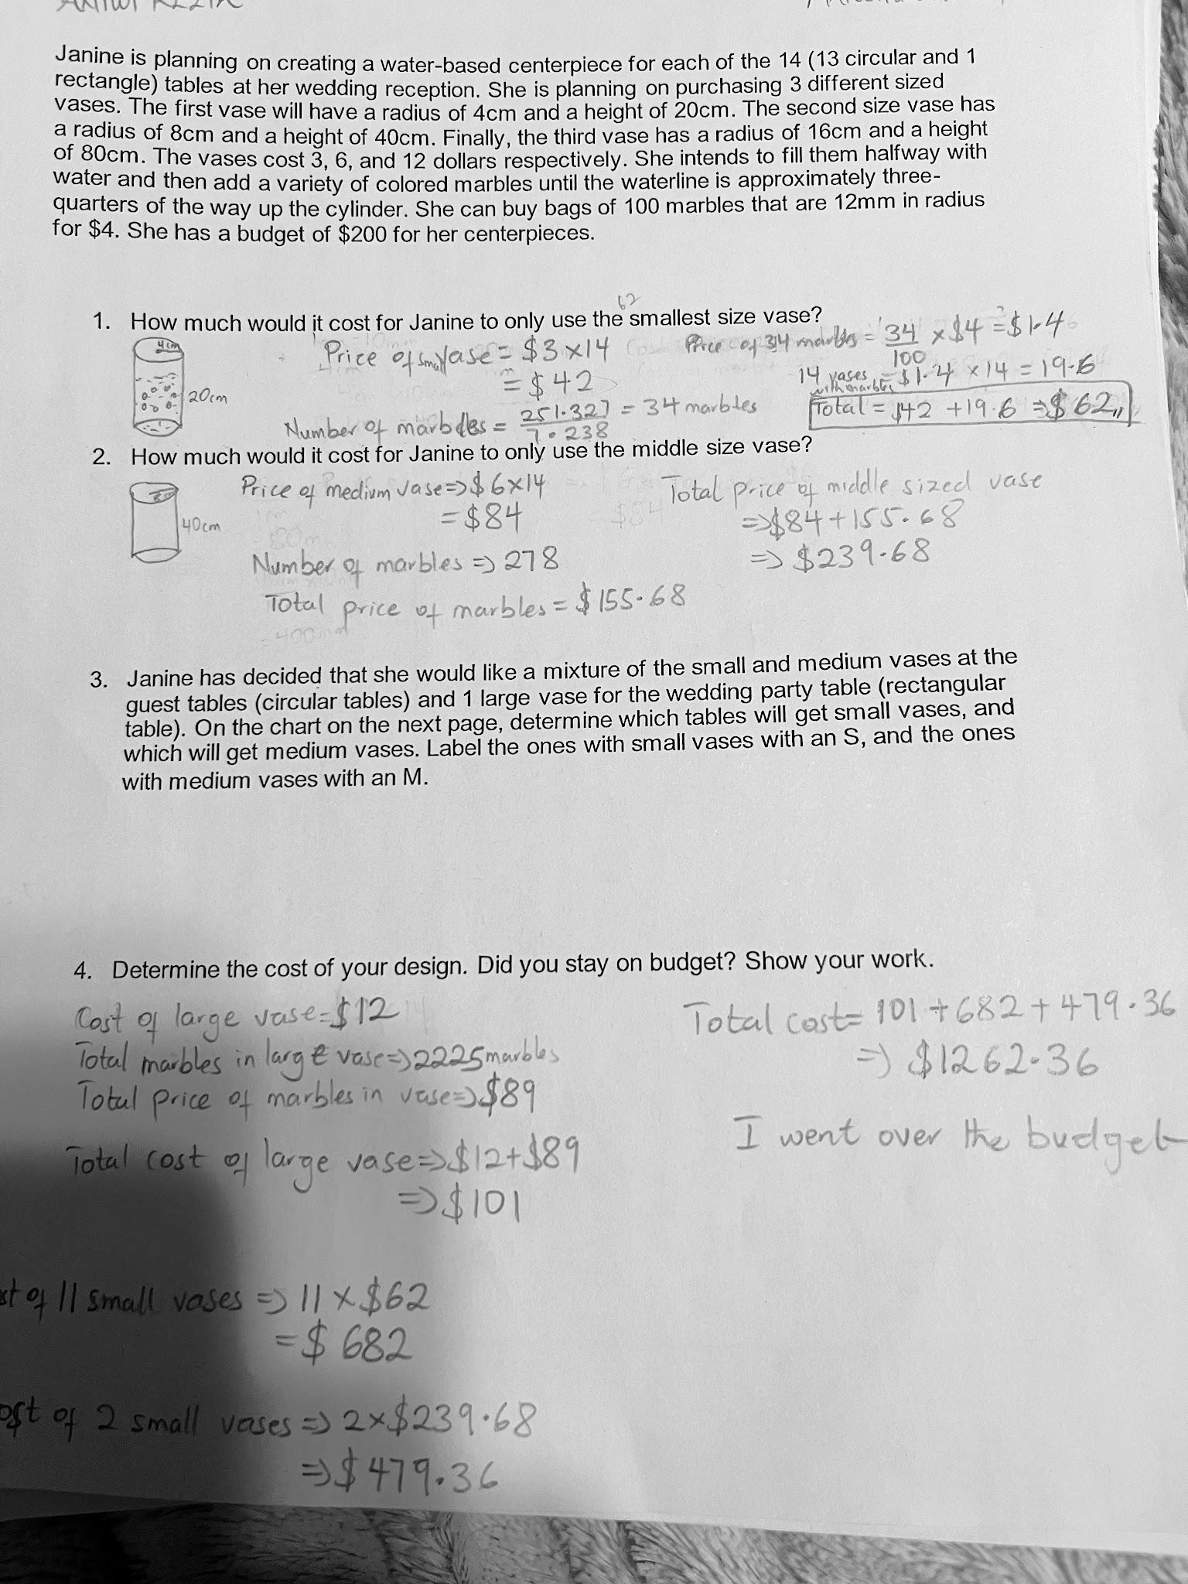
Round 1:What
do you notice?
Jot down one thing you notice about this piece of student work..
Notes:
Facilitation Note
Give participants time to study student work.
Share in chat:
—
Please see pages 8 - 10 in your handout.
—

Slide 27
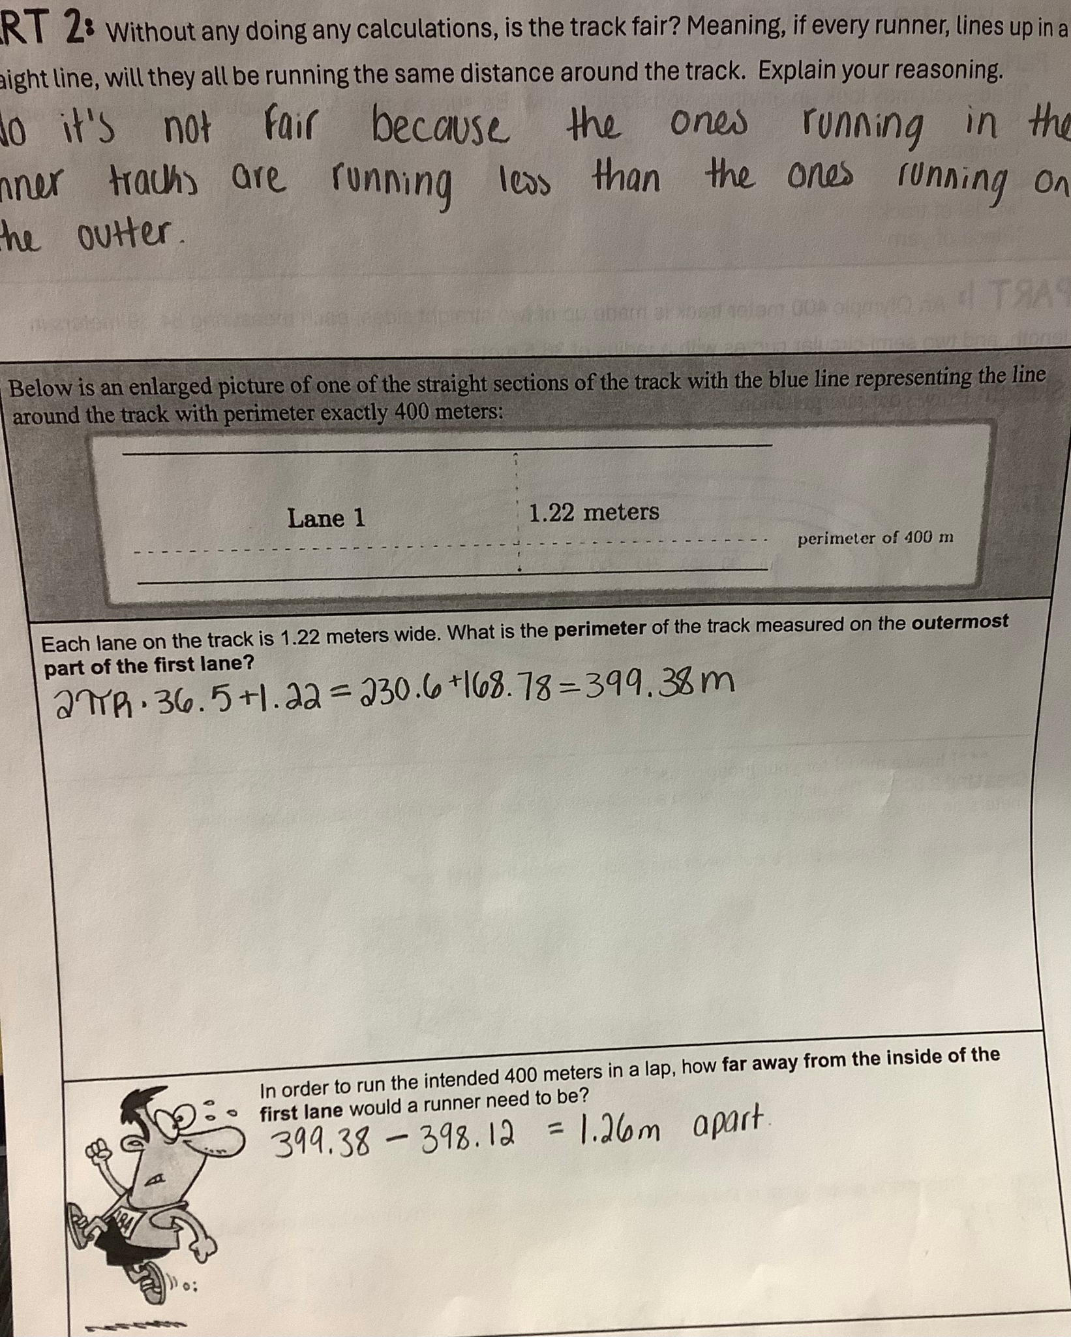
Round 1:What do you notice?
Jot down one thing you notice about this piece of student work..
Come off mute and share what you saw!
Notes:
Facilitation Note
Invite participants to share what they noticed.
Look for trends in responses, especially as connected to CPE 151.b: Use geometric shapes, their measures, and their properties to describe objects.

Slide 28
Humanizing Assessment
Feedback helps us remember that learning is messy, in the best possible way! Every moment in the classroom is an opportunity to gather street data on the cognitive complexities of learning- the aha moments, the stumbling blocks, the bursts of creativity, the spirals of self-doubt and shame, the neurological effects of stress and trauma. Rather than contribute to our understanding of what’s getting in the way for students, grades often create added stress and emotional pressure, particularly for children with learning differences and those struggling to catch up to grade level. (Safir and Dugan, 2021, p. 117)
Source: Safir, Shane, and Jamila Dugan. Street Data: A Next-Generation Model for Equity, Pedagogy, and School Transformation. Corwin, 2021.
Notes:
Facilitation Note:
Share the quote. Ask participants to reflect on how the criteria and the ideas in the quote require rethinking something in their current practice.

Slide 29
Criteria for Success
Conference and Provide Revision Support | Accept with Revision | Accept
The student’s artifact shows evidence of an emerging understanding of the targeted expectation(s). After conferencing and additional instruction/learning, the student may provide a revised or different artifact as evidence of their learning. | The student’s artifact shows evidence of approaching a full understanding of the targeted expectation(s). The artifact may contain execution errors that should be corrected in revision. The student may revise the selected artifact or submit a different artifact. | The student’s artifact demonstrates evidence that they have met the targeted expectation(s).
What resonates with you? What questions surace for you?
Notes:
Facilitation Note
Introduce criteria for success.
Ask: “what resonates with you? What questions surface for you?”
Consider use of breakout groups.
Share in chat:
—
Please see page 16 in your handout.
—

Slide 30
Round 2:
What evidence of learning is there?
Let’s examine some work together:
Conference and Provide Revision Support
The student’s artifact shows evidence of an emerging understanding of the targeted expectation(s). After conferencing and additional instruction/ learning, the student may provide a revised or different artifact as evidence of their learning.
Accept with Revision
The student’s artifact shows evidence of approaching a full understanding of the targeted expectation(s). The artifact may contain execution errors that should be corrected in revision. The student may revise the selected artifact or submit a different artifact.
Accept
The student’s artifact demonstrates evidence that they have met the targeted expectation(s).
151.b: Use geometric shapes, their measures, and their properties to describe objects.
Notes:
Facilitation Note
Use this slide to set up what folks will do- next slide illustrate space to capture thinking.
They will examine the student work.
Determine where that work falls along the criteria for success spectrum.
And add a post it sharing what evidence of success is present.
We will focus our lens on the CPE displayed on the slide: 151.b

Slide 31

Examining Student Work
Conference and Provide Revision Support | Accept with Revision | Accept
Your thoughts about the evidence visible in the work.
Drag a checkmark to the Criteria for Success to reflect evidence of learning
Type out your thoughts
Notes:
Facilitation Note
Facilitator will need to make a copy of the editable Google Slide Deck and share that link with participants.
Invite participants to edit the Google slide accordingly, sharing:
Where they think the evidence of learning is along the Criteria for Success spectrum (using the check marks provided).
If the student was here, what question(s) would you pose to understand what they know?
Remind participants to focus on the CPEs to help guide decision making.
If they find the student work falls within the first two categories, consider inviting folks to consider and share what “conferring and additional instruction/learning” might look like for that student, as time permits.
Share that directions are on the first slide.
Navigate to Google Slides file to illustrate use of tools as needed.

Slide 32
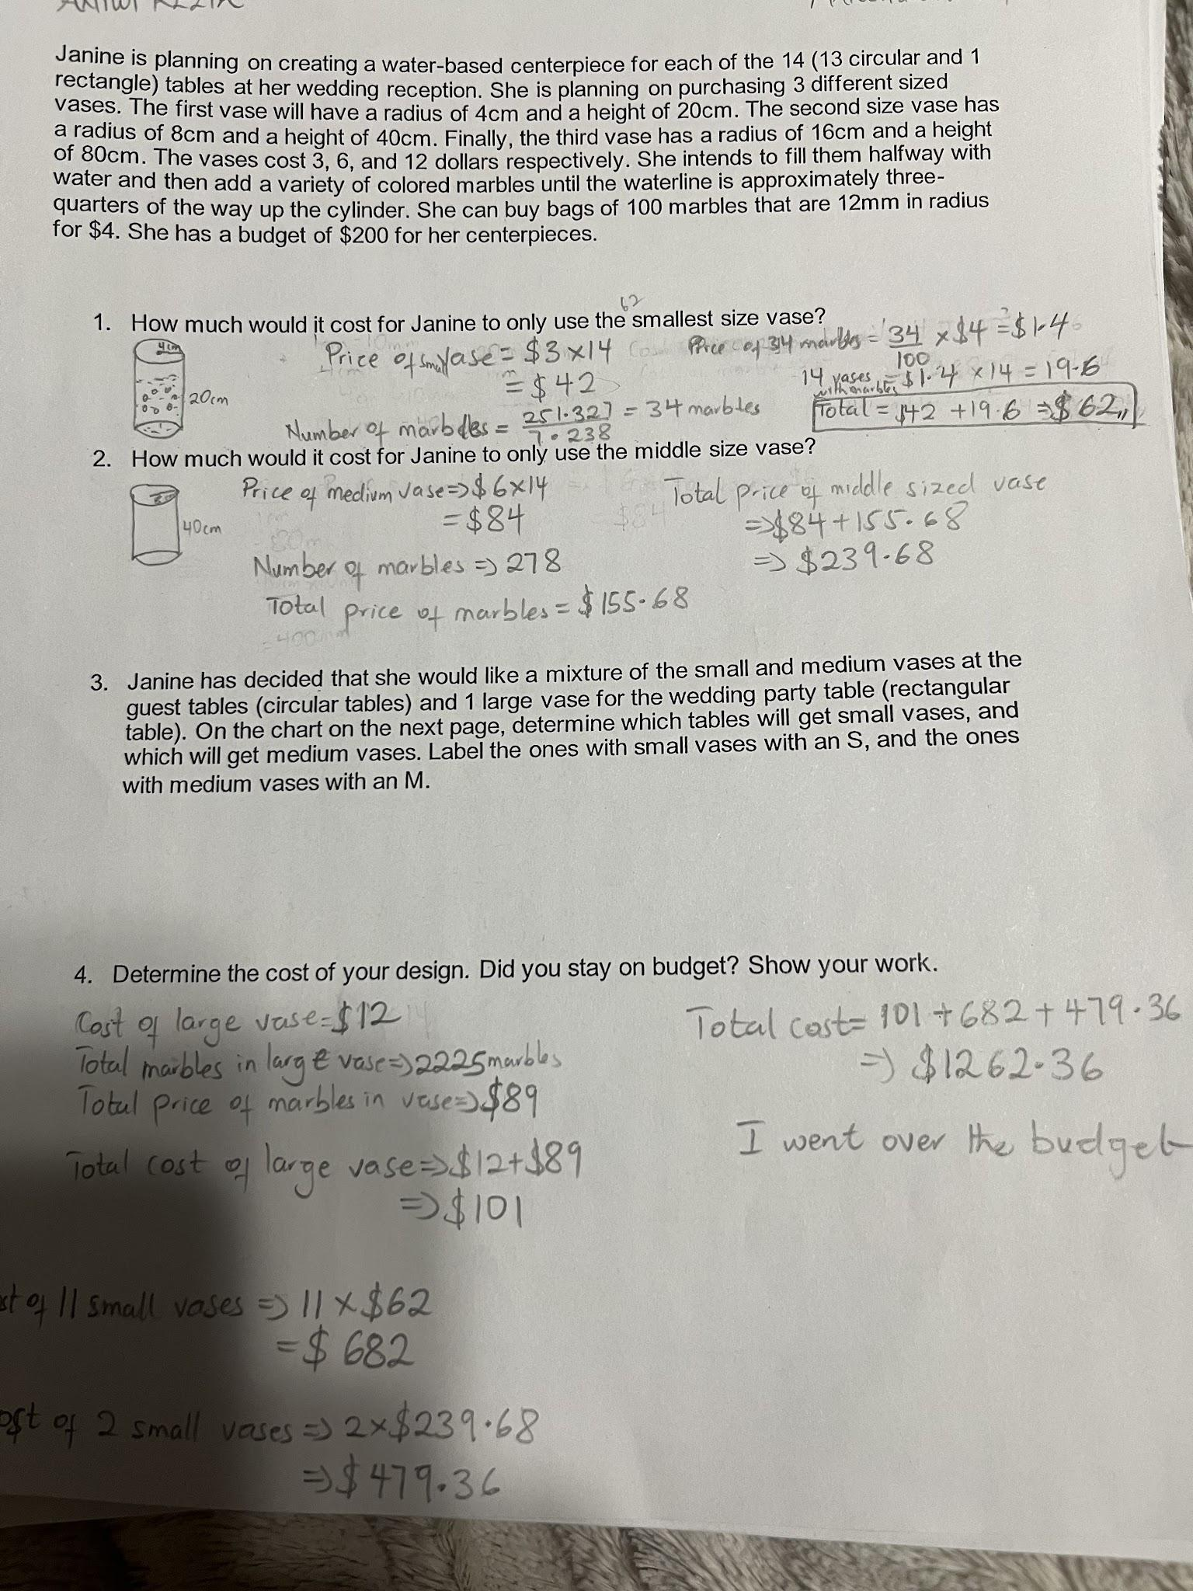
Example #1
Let’s compare notes
Notes:
Facilitation Note
Use this slide to discuss how folks thought about the student work, in terms of the Criteria for Success chart.
This is meant to give time for group to build shared understanding of how to use the CPEs alongside the rubric to share ways of partnering with students to support all students reaching.
This is not a norming exercise; there is not single correct characterization of the work. Emphasize use of evidence and concrete next steps from each participant to support student learning.

Slide 33
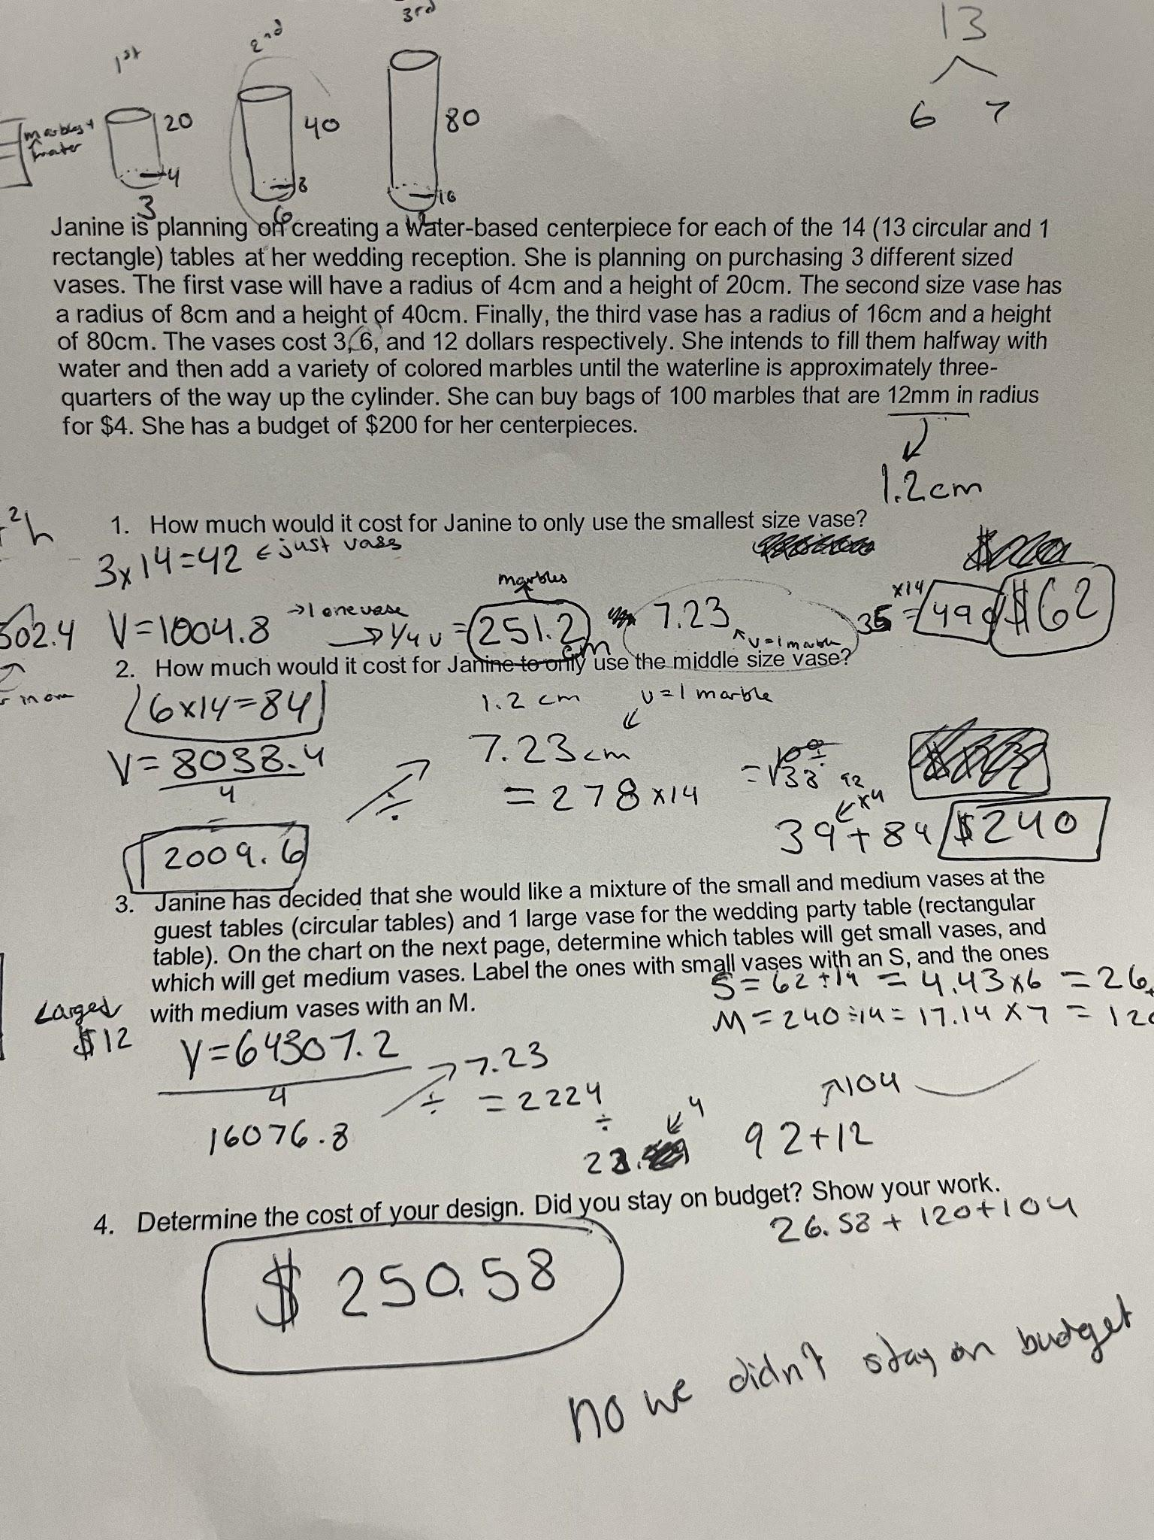
Example #2
Let’s compare notes
Notes:
Facilitation Note
Use this slide to discuss how folks thought about the student work, in terms of the Criteria for Success chart.
This is meant to give time for group to build shared understanding of how to use the CPEs alongside the rubric to share ways of partnering with students to support all students reaching.
This is not a norming exercise; there is not single correct characterization of the work. Emphasize use of evidence and concrete next steps from each participant to support student learning.

Slide 34
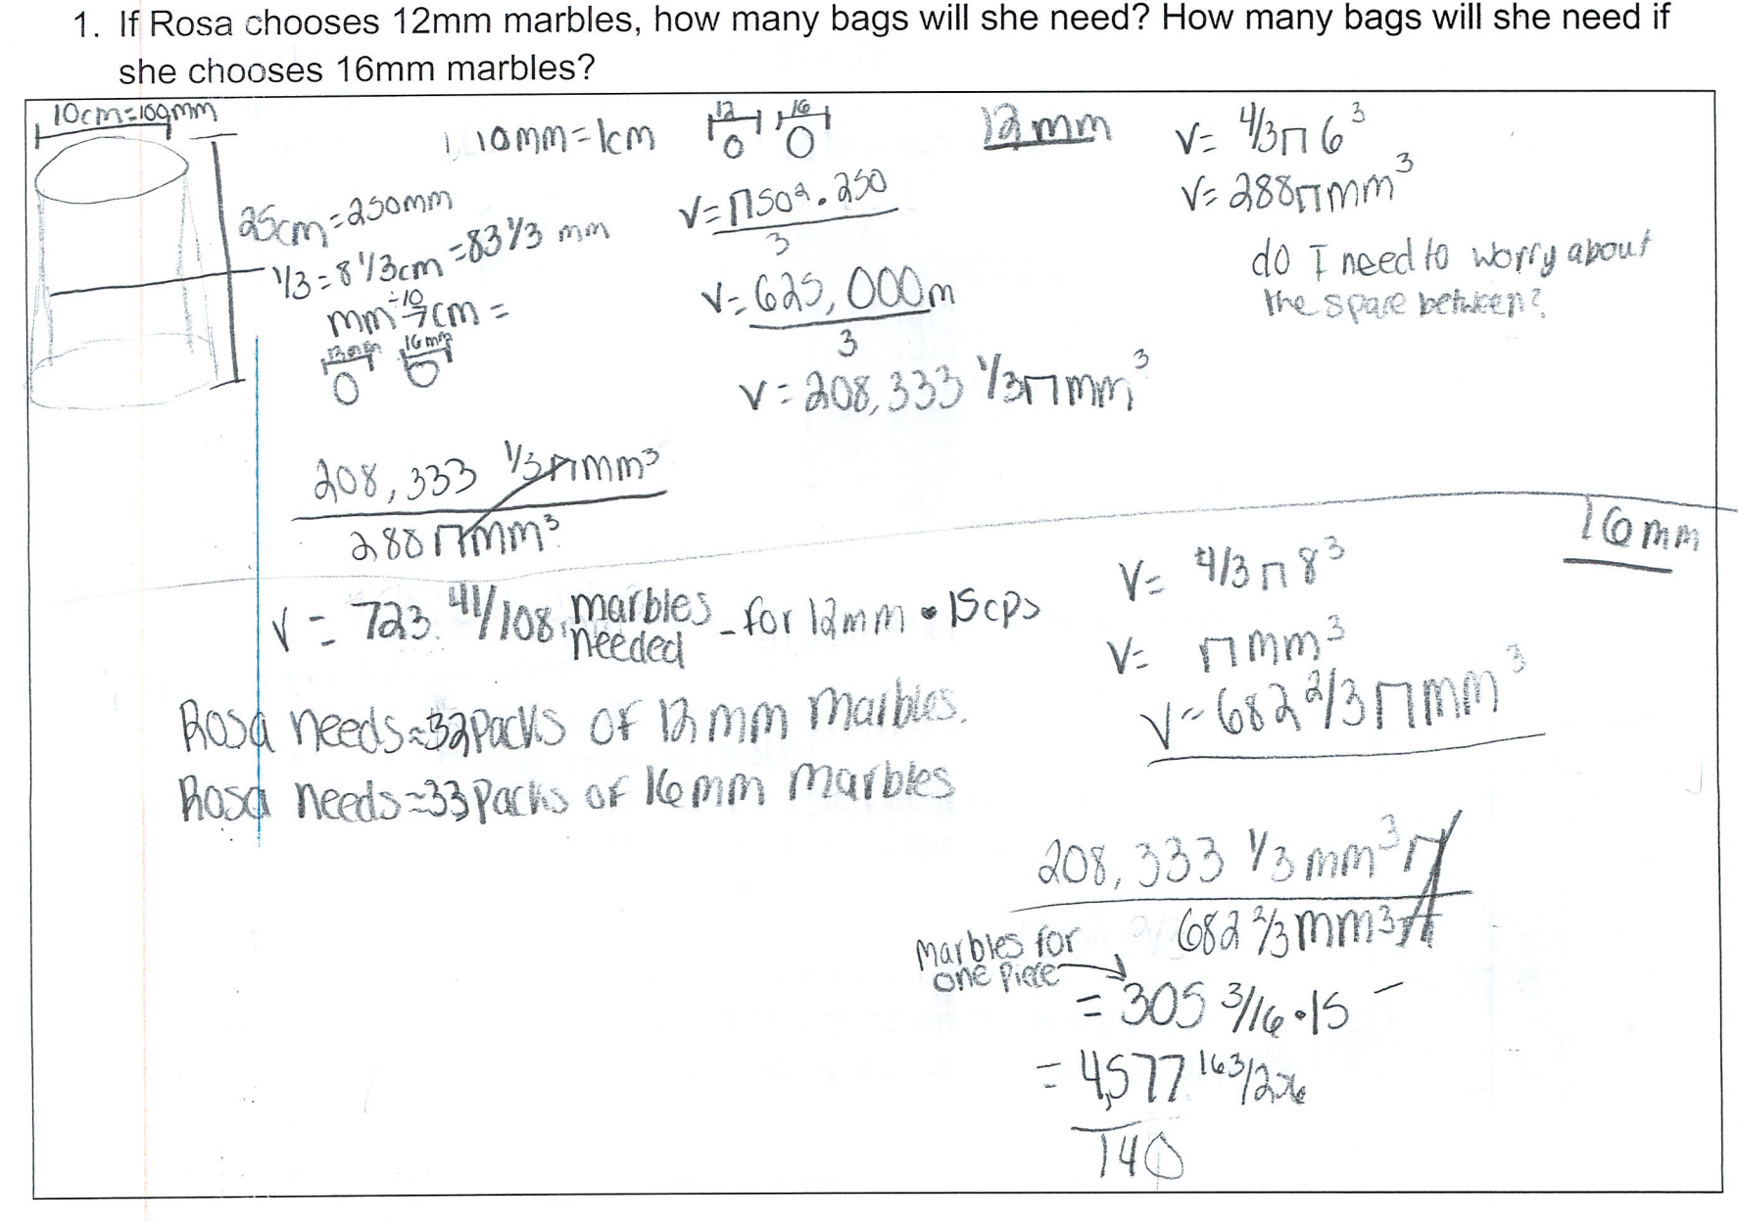
Example #3
Let’s compare notes
Notes:
Facilitation Note
Use this slide to discuss how folks thought about the student work, in terms of the Criteria for Success chart.
This is meant to give time for group to build shared understanding of how to use the CPEs alongside the rubric to share ways of partnering with students to support all students reaching.
This is not a norming exercise; there is not single correct characterization of the work. Emphasize use of evidence and concrete next steps from each participant to support student learning.

Slide 35
Three Key Components of the Math Badging System
Content and Practice Expectations
Learning Principles
Criteria for Success
Which one excites you the most?
What one will have the greatest impact on students?
What questions surface for you?
Come off
mute or share in the chat!
Notes:
Facilitation Note
Give participants time to reflect. If time permits, consider using breakout rooms to have folks connect in smaller pairings or groups.
Invite to share with whole group.

Slide 36
04
Task 2: Expectations and Learning Principles
Notes:
Facilitation Note
Estimated time for this section is about 15 minutes.

Slide 37
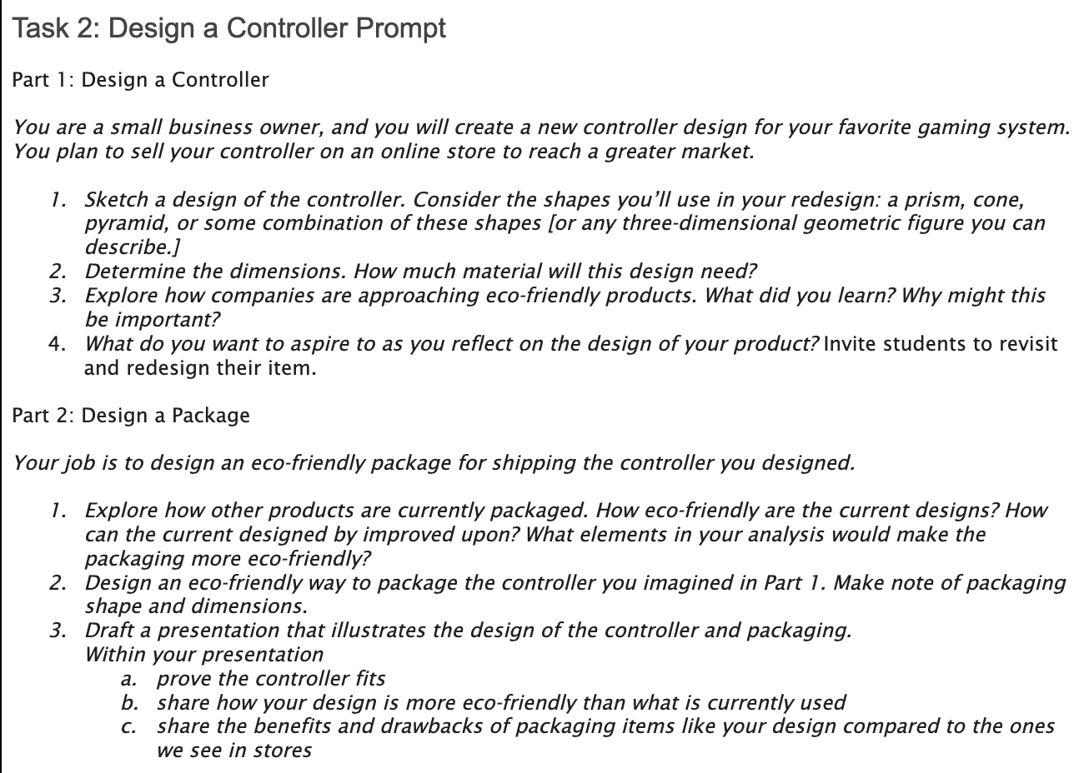
Let’s Do Some Math!
Do the task as a student would. Jot down any reflections that you have as you do the math!
Notes:
Facilitation Note
Give participants time to read through prompt and consider how students might approach this. Invite to try it out for themselves.
Share in chat:
—
Please see pages 11-12 in your handout.
—

Slide 38
Content and Practice Expectations
Choose 1-2 Content and Practice Expectations that student work could give evidence of.
Notes:
Facilitation Note
Give time to read and connect.
Consider use of breakout rooms to give participants time to discuss with small group.

Slide 39
Content and Practice Expectations
151.d: Apply geometric methods to solve design problems.
Notes:
Facilitation Note
Encourage participants to use the content and practice expectations (CPE) to support their thinking.
A good CPE to focus on for this task is 151.d: Apply geometric methods to solve design problems.

Slide 40
Learning
Principles
In M151 Modeling with Geometry, students will employ the following learning principles:
Engage with cognitively demanding tasks in heterogeneous settings (LP 1).
Engage in social activities (LP 2).
Build conceptual understanding through reasoning (LP 3).
Have agency in their learning (LP 4).
View mathematics as a human endeavor across centuries (LP 5).
See mathematics as relevant (LP 6).
Employ technology as a tool for problem-solving and understanding (LP 7).
Notes:
Facilitation Note
Share our vision for the student experience and how we did our best to capture that with these 7 learning principles.
Give participants time to read and access the copy.
Share in chat:
—
Please see page 7 in your handout.
—

Slide 41
Learning
Principles
In M151 Modeling with Geometry, students will employ the following learning principles:
Engage with cognitively demanding tasks in heterogeneous settings (LP 1).
Engage in social activities (LP 2).
Build conceptual understanding through reasoning (LP 3).
Have agency in their learning (LP 4).
View mathematics as a human endeavor across centuries (LP 5).
See mathematics as relevant (LP 6).
Employ technology as a tool for problem-solving and understanding (LP 7).
Which of these principles does this task lend itself to? Which ones can the task be easily adapted to accommodate?
Notes:
Facilitation Note
Give time for participants to consider these questions.
Consider use of breakout rooms for small group conversation.

Slide 42
Learning
Principles
In M151 Modeling with Geometry, students will employ the following learning principles:
Engage with cognitively demanding tasks in heterogeneous settings (LP 1).
Engage in social activities (LP 2).
Build conceptual understanding through reasoning (LP 3).
Have agency in their learning (LP 4).
View mathematics as a human endeavor across centuries (LP 5).
See mathematics as relevant (LP 6).
Employ technology as a tool for problem-solving and understanding (LP 7).
Share what
you came up with!
Notes:
Facilitation Note
Invite participants to share with the whole group.

Slide 43
05
Task 2: Student Work
Notes:
Facilitation Note
Estimated time for this section is about 30 minutes.

Slide 44
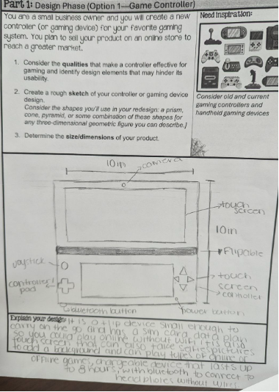
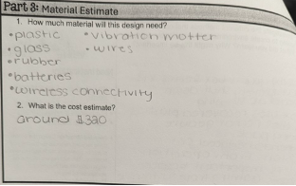
Round 1:What
do you notice?
Jot down one thing you notice about this piece of student work..
Come off mute and share what you saw!
Notes:
Facilitation Note
Give participants time to study student work.
Share in chat:
—
Please see pages 13-15 in your handout.
—

Slide 45
Round 1:What
do you notice?
Jot down one thing you notice about this piece of student work..
Come off mute and share what you saw!
Notes:
Facilitation Note
Invite participants to share what they noticed.
Look for trends in responses, especially as connected to CPE 151.d: Apply geometric methods to solve design problems.

Slide 46
Round 2:
What evidence of learning is there?
Let’s examine some work together:
Conference and Provide Revision Support
The student’s artifact shows evidence of an emerging understanding of the targeted expectation(s). After conferencing and additional instruction/ learning, the student may provide a revised or different artifact as evidence of their learning.
Accept with Revision
The student’s artifact shows evidence of approaching a full understanding of the targeted expectation(s). The artifact may contain execution errors that should be corrected in revision. The student may revise the selected artifact or submit a different artifact.
Accept
The student’s artifact demonstrates evidence that they have met the targeted expectation(s).
151.d: Apply geometric methods to solve design problems.
Notes:
Facilitation Note
Remind participants of the criteria of success.
Use this slide to set up what folks will do- next slide illustrate space to capture thinking.
They will examine the student work.
Determine where that work falls along the criteria for success spectrum.
And add a checkmark and text sharing what evidence of success is present.
We will focus our lens on the CPE displayed on the slide: 151.d

Slide 47
Examining Student Work
Conference and Provide Revision Support | Accept with Revision | Accept
Your thoughts about the evidence visible in the work.
Drag a checkmark to the Criteria for Success to reflect evidence of learning
Type out your thoughts
Notes:
Facilitation Note
Facilitator will need to make a copy of the editable Google Slide Deck and share that link with participants.
Invite participants to edit the Google slide accordingly, sharing:
Where they think the evidence of learning is along the Criteria for Success spectrum (using the check marks provided).
If the student was here, what question(s) would you pose to understand what they know?
Remind participants to focus on the CPEs to help guide decision making.
If they find the student work falls within the first two categories, consider inviting folks to consider and share what “conferring and additional instruction/learning” might look like for that student, as time permits.
Share that directions are on the first slide.
Navigate to Google Slides file to illustrate use of tools as needed.

Slide 48
Example #1
Let’s compare notes.
Notes:
Facilitation Note
Use this slide to discuss how folks thought about the student work, in terms of the Criteria for Success chart.
This is meant to give time for group to build shared understanding of how to use the CPEs alongside the rubric to share ways of partnering with students to support all students reaching.
This is not a norming exercise; there is not single correct characterization of the work. Emphasize use of evidence and concrete next steps from each participant to support student learning.

Slide 49
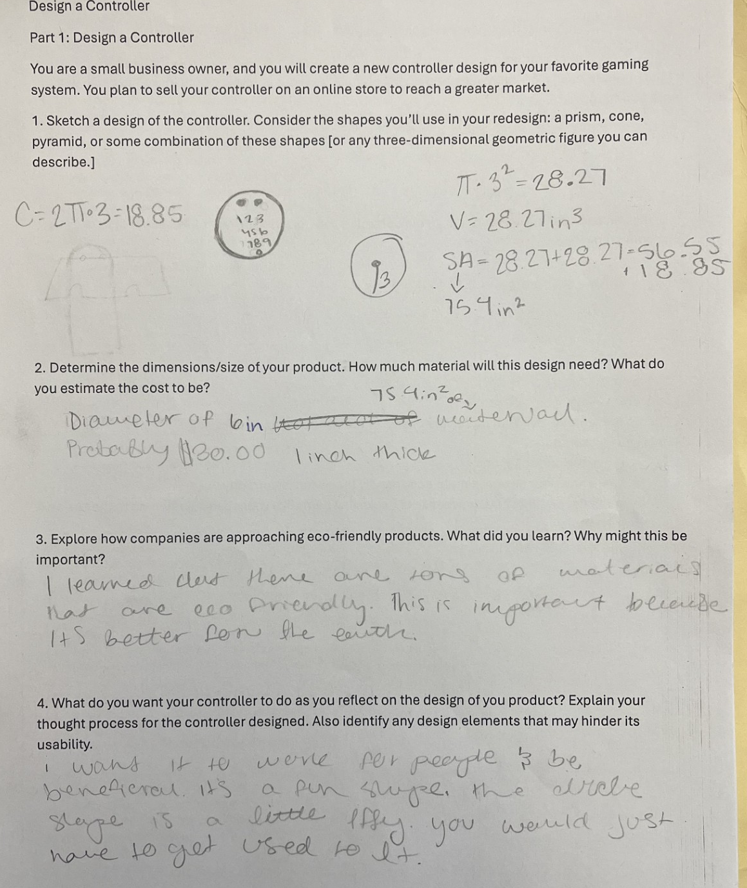
Example #2
Let’s compare notes.
Notes:
Facilitation Note
Use this slide to discuss how folks thought about the student work, in terms of the Criteria for Success chart.
This is meant to give time for group to build shared understanding of how to use the CPEs alongside the rubric to share ways of partnering with students to support all students reaching.
This is not a norming exercise; there is not single correct characterization of the work. Emphasize use of evidence and concrete next steps from each participant to support student learning.

Slide 50
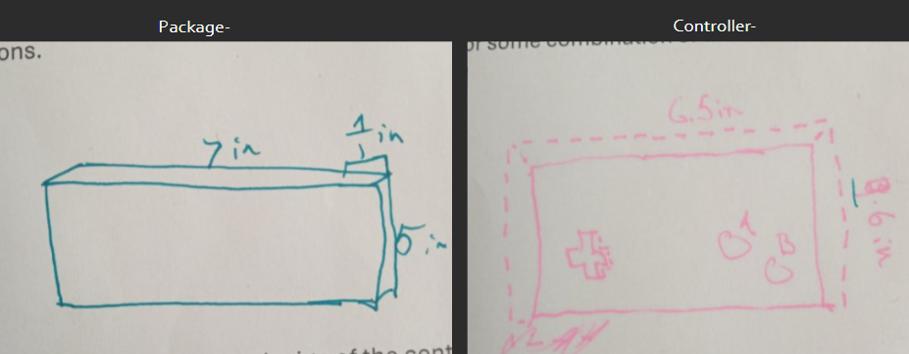
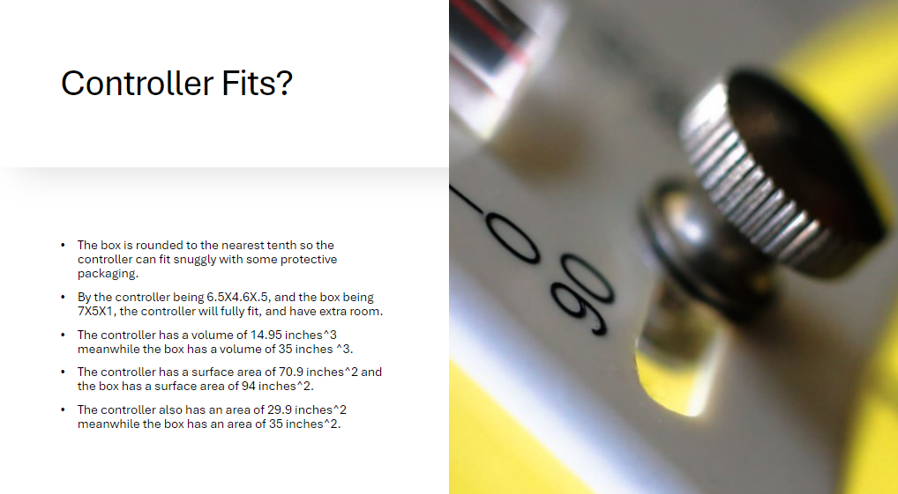
Example #3
Let’s compare notes.
Notes:
Facilitation Note
Use this slide to discuss how folks thought about the student work, in terms of the Criteria for Success chart.
This is meant to give time for group to build shared understanding of how to use the CPEs alongside the rubric to share ways of partnering with students to support all students reaching.
This is not a norming exercise; there is not single correct characterization of the work. Emphasize use of evidence and concrete next steps from each participant to support student learning.

Slide 51
Let’s Hear Some Reflections
What kinds of support will students need to demonstrate evidence of learning?
Has your thinking changed at all on how to implement this task? If so, how?
Come off
mute or share in the chat!
Notes:
Facilitation Note
Give participants time to reflect. If time permits, consider using breakout rooms to have folks connect in smaller pairings or groups.
Invite to share with whole group.

Slide 52
06
Closing
Notes:
Facilitation Note
Estimated time for this section is about 5 minutes.

Slide 53
What Are Your Takeaways?
Choose one question to respond to:
Which content and practice expectation are you most excited about? Why?
Which learning principle are you most excited about connecting to M151 content? Why?
What impact do you think using a portfolio system will have on your students? Why?
Notes:
Facilitation Note
Give participants time to reflect. If time permits, consider using breakout rooms to have folks connect in smaller pairings or groups.
Invite to share with whole group.

