Slide 1
Looking at Student Work
Directions
Examine the student work.
Determine where evidence of learning is along the Criteria for Success spectrum. Move a checkmark to the corresponding placement.
Add a note including your thoughts about the evidence visible in the work.
Consider the following questions:
  What evidence of success is present? What does the student know?
  If the student was here, what question(s) would you post to understand what they know?

Slide 2
Criteria for Success
Conference and Provide Revision Support | Accept with Revision | Accept
The student’s artifact shows evidence of an emerging understanding of the targeted expectation(s). After conferencing and additional instruction/learning, the student may provide a revised or different artifact as evidence of their learning. | The student’s artifact shows evidence of approaching a full understanding of the targeted expectation(s). The artifact may contain execution errors that should be corrected in revision. The student may revise the selected artifact or submit a different artifact. | The student’s artifact demonstrates evidence that they have met the targeted expectation(s).

Slide 3

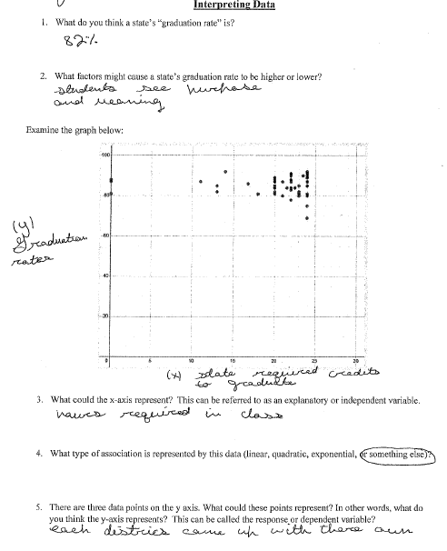
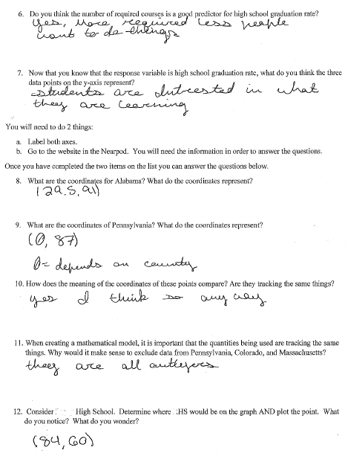
Conference and Provide Revision Support | Accept with Revision | Accept
Your thoughts about the evidence visible in the work.
Example #1
Let’s practice!
Which of the following best describes the next steps for this work sample? (Conference with revision support, Accept with revision, or Accept)
What feedback would you give this student?
112.g: Assess the fit of a function using the correlation coefficient, residuals, and other tools.

Slide 4
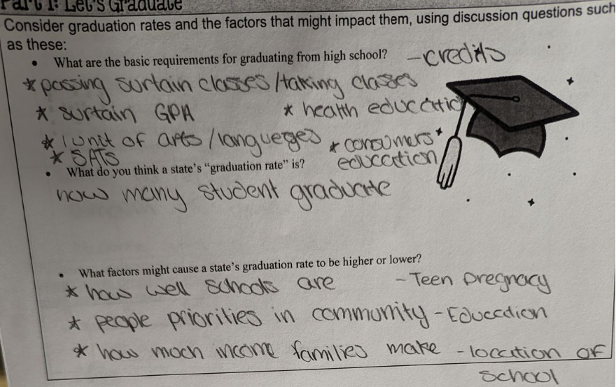
Conference and Provide Revision Support | Accept with Revision | Accept
Your thoughts about the evidence visible in the work.
Example #2
Let’s practice!
Which of the following best describes the next steps for this work sample? (Conference with revision support, Accept with revision, or Accept)
What feedback would you give this student?
112.g: Assess the fit of a function using the correlation coefficient, residuals, and other tools.

Slide 5
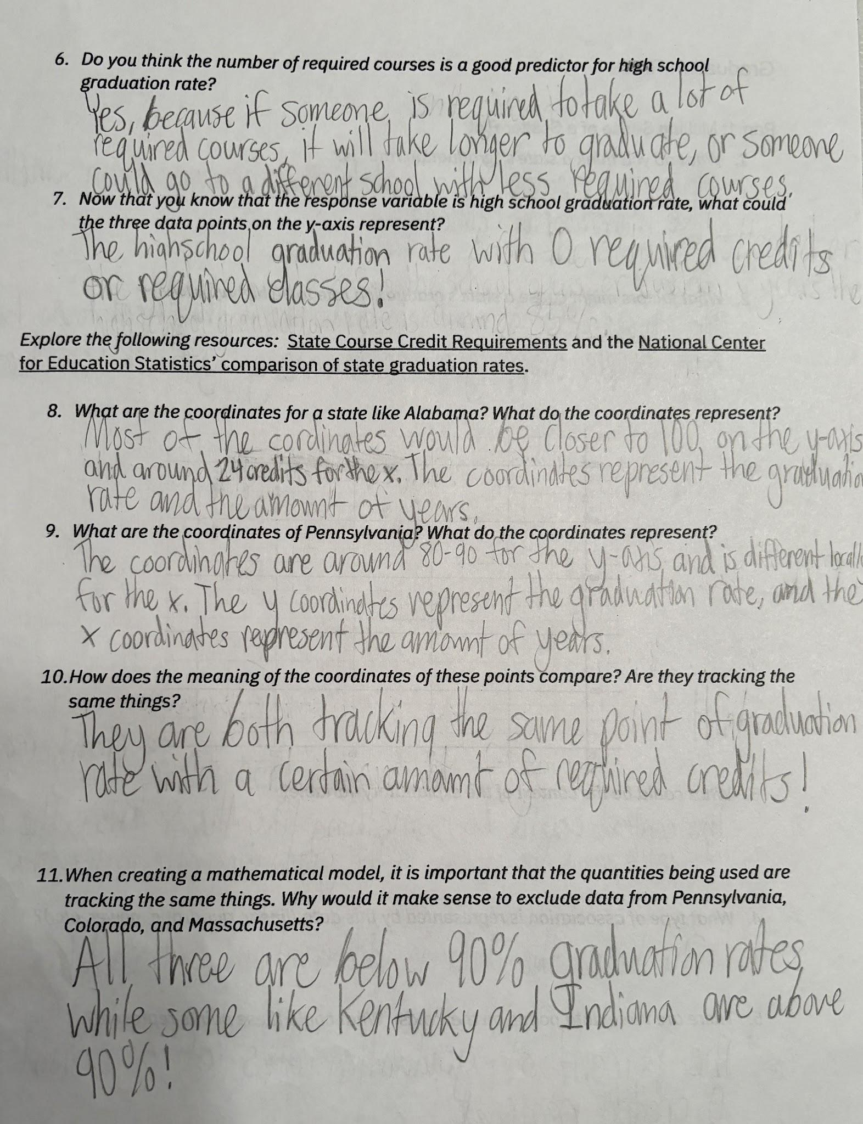
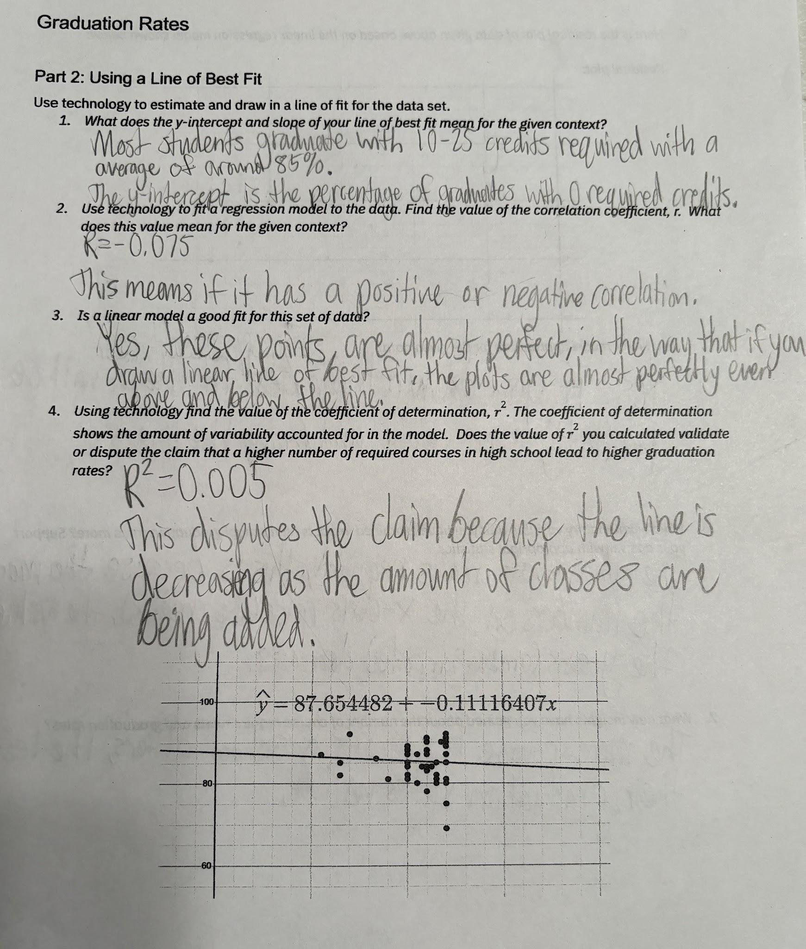
Conference and Provide Revision Support | Accept with Revision | Accept
Your thoughts about the evidence visible in the work.
Example #3
Let’s practice!
Which of the following best describes the next steps for this work sample? (Conference with revision support, Accept with revision, or Accept)
What feedback would you give this student?
112.g: Assess the fit of a function using the correlation coefficient, residuals, and other tools.

Slide 6
Criteria for Success
Conference and Provide Revision Support | Accept with Revision | Accept
The student’s artifact shows evidence of an emerging understanding of the targeted expectation(s). After conferencing and additional instruction/learning, the student may provide a revised or different artifact as evidence of their learning. | The student’s artifact shows evidence of approaching a full understanding of the targeted expectation(s). The artifact may contain execution errors that should be corrected in revision. The student may revise the selected artifact or submit a different artifact. | The student’s artifact demonstrates evidence that they have met the targeted expectation(s).

Slide 7
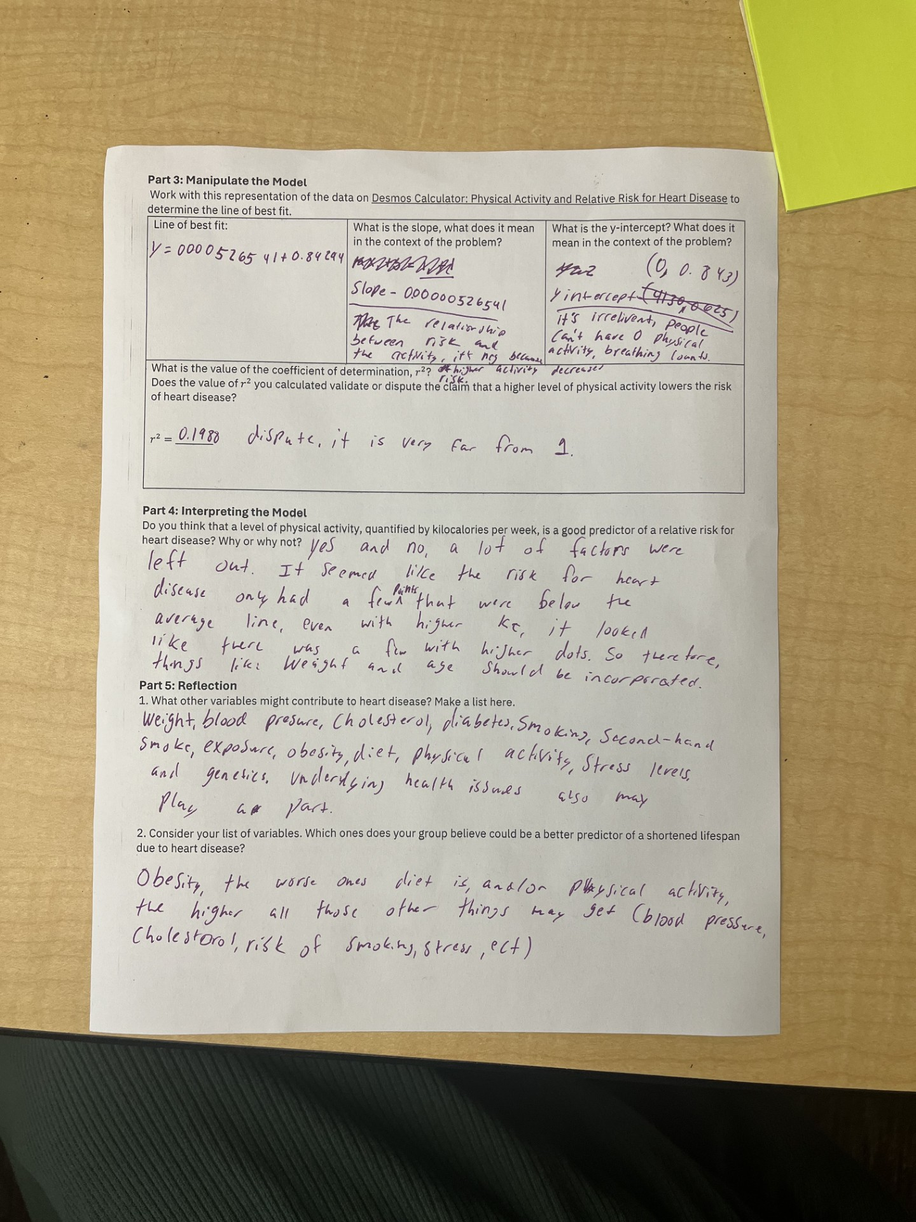
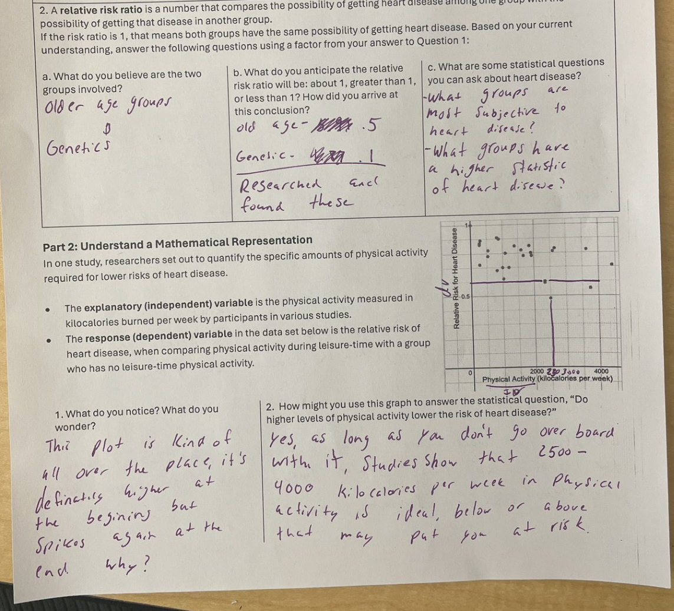
Conference and Provide Revision Support | Accept with Revision | Accept
Your thoughts about the evidence visible in the work.
Example #1
Let’s practice!
Which of the following best describes the next steps for this work sample? (Conference with revision support, Accept with revision, or Accept)
What feedback would you give this student?
112.h: Explain insights gained from analyzing two-variable measurement data and limitations of curves fitted to data.

Slide 8
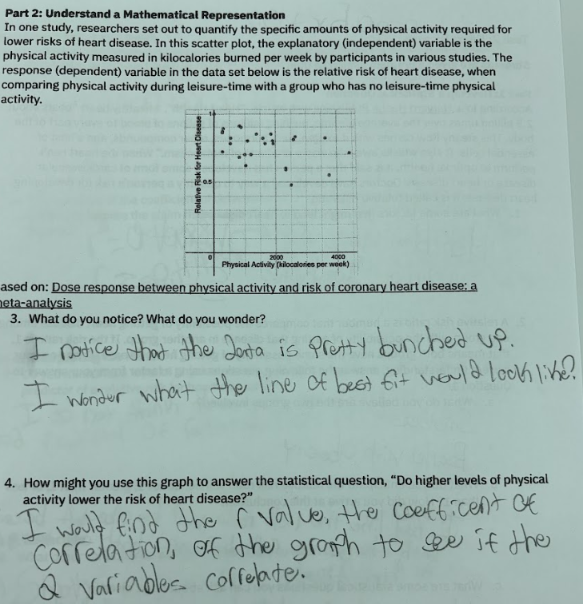
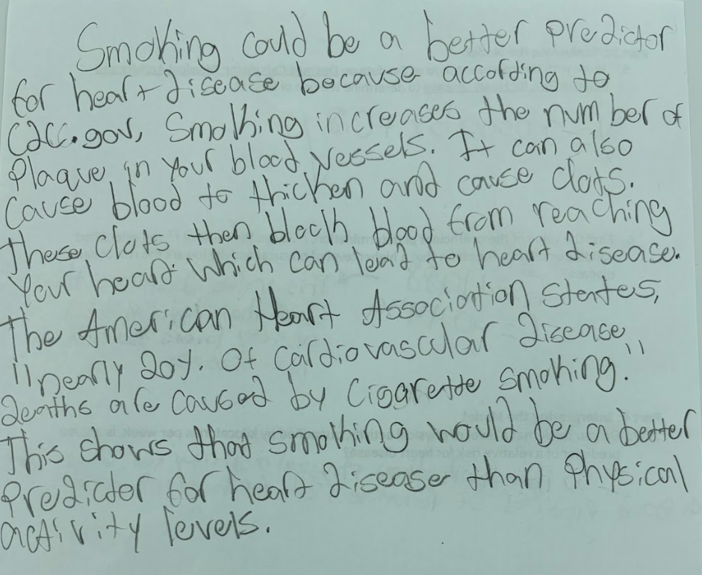
Conference and Provide Revision Support | Accept with Revision | Accept
Your thoughts about the evidence visible in the work.
Example #2
Let’s practice!
Which of the following best describes the next steps for this work sample? (Conference with revision support, Accept with revision, or Accept)
What feedback would you give this student?
112.h: Explain insights gained from analyzing two-variable measurement data and limitations of curves fitted to data.

Slide 9
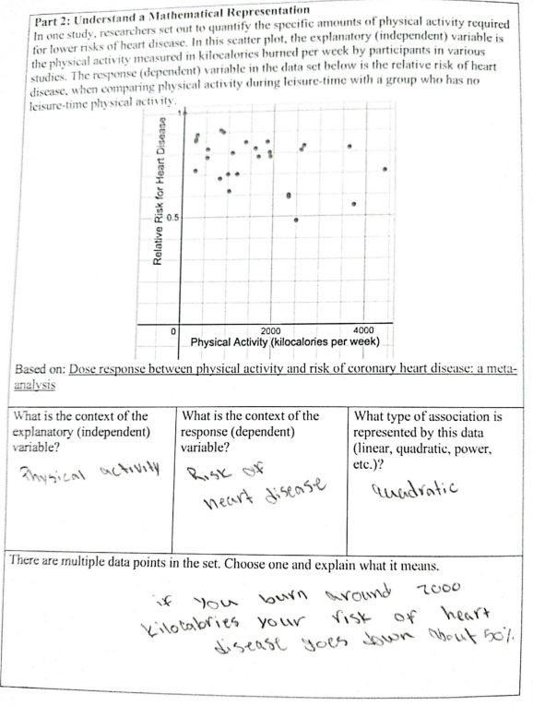
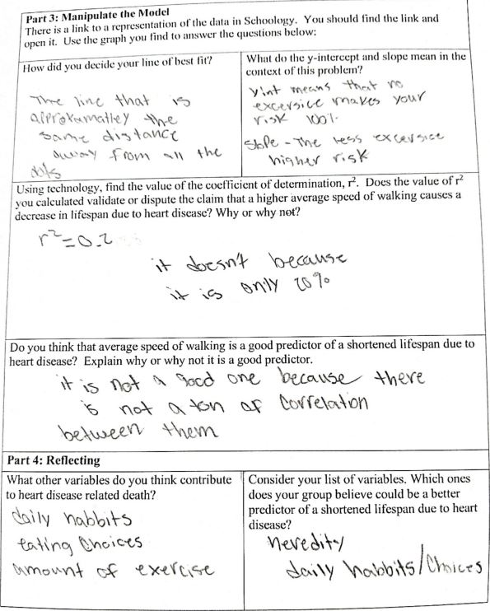
Conference and Provide Revision Support | Accept with Revision | Accept
Your thoughts about the evidence visible in the work.
Example #3
Let’s practice!
Which of the following best describes the next steps for this work sample? (Conference with revision support, Accept with revision, or Accept)
What feedback would you give this student?
112.h: Explain insights gained from analyzing two-variable measurement data and limitations of curves fitted to data.

