Slide 1
Preparation Notes
Please review and customize this deck to prepare it for use. Some notes:
These professional learning (PL) materials (slide deck and accompanying handout) are being offered in editable forms so that you may make adjustments to better support the specific work happening in your school or district.
These PL materials are designed to easily accommodate remote delivery:
  An editable Google Slide Deck is provided to facilitate discussion of student work; the facilitator will need to make a copy of this and be ready to share the link with participants as noted in the deck. Encourage participants to Zoom out of the slide deck in order to view all interactive features.
  Text that can be readily pasted (marked with “—”) into a video call’s chat feature is included when participants need to reference the handout.
  There are placeholders for handout links to be shared with participants in the notes field of selected slides; the facilitator will need to add a link to the handout where indicated by “[insert link].”

Slide 2

M113 Overview
XQ Badge Project PL Series Baseline Session
Month XX, XXXX
Notes:
Session time frame: 1.5

Slide 3
Welcome!
Joining Question:
What do you do to “reset” during breaks from school?
Notes:
Facilitation Note
Have each educator answer these questions in order to introduce themselves.

Slide 4


Outcomes and Agenda
Participants will be able to:
Agenda:
Explain the content and practice expectations for the M113 badge
Analyze tasks through the lenses of (1) content and practice expectations and (2) learning principles
Analyze student work for evidence of learning
Exploring the Content
Task 1: Expectations and Learning Principles
Task 1: Student Work
Task 2: Expectations and Learning Principles
Task 2: Student Work
Closing
Notes:
Facilitation Note
Give overview of session goals and agenda.
Remind participants as well that they are encouraged to:
Be present as much as possible.
Have a place to write and do math.
Share your thinking.
Respond to others.
Maintain an asset orientation.

Slide 5
01
Exploring the Content
Notes:
Facilitation Note
Estimated time for this section is about 25 minutes.

Slide 6
Learning Principles
Engage with cognitively demanding tasks in heterogeneous settings.
Engage in social activities.
Build conceptual understanding through reasoning.
Have agency in their learning.
View mathematics as a human endeavor across centuries.
See mathematics as relevant.
Employ technology as a tool for problem solving and understanding.
Which learning principle would you like to focus on today?
Notes:
Facilitation Note
This slide serves to remind participants about the learning principles that undergird the bading system.
Give time to consider this question and invite folks to share with a partner and the whole group.

Slide 7
M113 Modeling with Probability
What comes to mind?
What knowledge and skills should students learn to earn this badge?
Put your thoughts in the chat!
Notes:
Facilitation Note
Give participants time to consider the questions on this slide. Invite volunteers to share responses with the group.

Slide 8
What’s the Story of these Standards?
Understand independence and conditional probability and use them to interpret data.
Describe events as subsets of a sample space (the set of outcomes) using characteristics (or categories) of the outcomes, or as unions, intersections, or complements of other events (“or,” “and,” “not”).
Understand that two events A and B are independent if the probability of A and B occurring together is the product of their probabilities, and use this characterization to determine if they are independent.
Understand the conditional probability of A given B as P(A and B)/P(B), and interpret independence of A and B as saying that the conditional probability of A given B is the same as the probability of A, and the conditional probability of B given A is the same as the probability of B.
Selected Common Core Standards for Mathematics - Statistics and Probability
Understand and evaluate random processes underlying statistical experiments.
Understand statistics as a process for making inferences about population parameters based on a random sample from that population.
Decide if a specified model is consistent with results from a given data-generating process, e.g., using simulation. For example, a model says a spinning coin falls heads up with probability 0.5. Would a result of 5 tails in a row cause you to question the model?
How would you synthesize these?
What are the key takeaways
for students?
Notes:
Facilitation Note
Share that our process began by grounding in the standards and identifying the story of the standards.
Invite participants to read through the standards associated with this badge in the handout. (The slide image shows only a partial list.)
Frame this by asking participants to consider how they would synthesize these set of standards.
Share link to document in chat:
—-
Link to Handout: (insert link here)
Feel free to download a copy.
Please see page 2 in your handout.
—-

Slide 9
What’s the Story of these Standards?
Understand independence and conditional probability and use them to interpret data.
Describe events as subsets of a sample space (the set of outcomes) using characteristics (or categories) of the outcomes, or as unions, intersections, or complements of other events (“or,” “and,” “not”).
Understand that two events A and B are independent if the probability of A and B occurring together is the product of their probabilities, and use this characterization to determine if they are independent.
Understand the conditional probability of A given B as P(A and B)/P(B), and interpret independence of A and B as saying that the conditional probability of A given B is the same as the probability of A, and the conditional probability of B given A is the same as the probability of B.
Selected Common Core Standards for Mathematics - Statistics and Probability
Understand and evaluate random processes underlying statistical experiments.
Understand statistics as a process for making inferences about population parameters based on a random sample from that population.
Decide if a specified model is consistent with results from a given data-generating process, e.g., using simulation. For example, a model says a spinning coin falls heads up with probability 0.5. Would a result of 5 tails in a row cause you to question the model?
Share your thinking!
Notes:
Facilitation Note
Invite volunteers to share responses with the group.
Share in chat:
—
What are the are the key takeaways for students?
—

Slide 10
M113 Content and Practice Expectations (CPE)
113.a | Engage in the modeling cycle.
113.b | Understand and evaluate random processes underlying statistical experiments.
113.c | Use a model to determine the probability of an event.
113.d | Use the rules of probability to compute probabilities of compound events.
113.e | Understand independence and conditional probability and use them for modeling.
113.f | Use probability to make decisions.
Notes:
Facilitation Note
Share these are the Content and Practice Expectations (CPE) we landed on.
Give participants some time to read and consider: what in our list of Content Practice Expectations resonates with you? What surprises you?
Share in chat:
—
Link to Handout: (insert link here)
Feel free to download a copy.
Please see page 6 in your handout.
—

Slide 11
M113 Content and Practice Expectations (CPE)
113.a | Engage in the modeling cycle.
113.b | Understand and evaluate random processes underlying statistical experiments.
113.c | Use a model to determine the probability of an event.
113.d | Use the rules of probability to compute probabilities of compound events.
113.e | Understand independence and conditional probability and use them for modeling.
113.f | Use probability to make decisions.
What
resonates with you?
Notes:
Facilitation Note
Invite participants to share with the group.
Share that we will continue to build a shared understanding of these through sample prompts.
“Problem solving puts the world in service of the math, modeling puts math in the service of the world”

Slide 12
Let’s Investigate
Choose at least one task to explore:
Rain and Lightning
Rolling Dice
Which content and practice expectations are evident in each one?
random.org is a good replacement for physical dice
Notes:
Facilitation Note
Invite participants to select a task and look for connections to badge CPEs.
Offer enough time for everyone to engage with at least one task; participants do not need to look at both.
Consider use of self-select breakout rooms to give participants time to discuss with small group.
Share in chat:
—
Please see pages 7-8 in your handout.
—

Slide 13
Let’s Investigate
Choose at least one task to explore:
Rain and Lightning
Rolling Dice
Which content and practice expectations are evident in each one?
Come off mute or put your thoughts in the chat! What did you find?
Notes:
Facilitation Note
Invite volunteers to share connections they see to each of the tasks.
Highlight responses where participants have identified one or more CPEs.

Slide 14
What’s the Same? What’s Different?
How do these content and practice expectations align to ways you’ve taught this topic before?
How are they different?
Come off mute or put your thoughts in the chat!
Notes:
Facilitation Note
Give participants some time to consider their responses to these questions then invite volunteers to share with whole group.

Slide 15
Math Gaps Create
Lasting Barriers
“And by 2018, problems with the pipeline through math courses and tests were persisting. Despite the implementation of new state standards and tests, just 31 percent of students were meeting or exceeding standards in math, compared with 56 percent in English.” (Daro & Asturias, 2019)
Notes:
Facilitation Note
Share this quote with group as a way to give insight into the why of this badging project.
Source: https://justequations.org/resource/branching-out-designing-high-school-math-pathways-for-equity

Slide 16
We Must Lead the Movement
Is math...?
Or could be math...?
About getting one right answer, the teacher’s way
Irrelevant
About doing procedures
Independent work
Something my teacher made up
Formulaic
About using multiple strategies flexibly
Connected to the real-world in ways that make sense
About understanding and applying
Collaborative work
Lived across continents and centuries
Novel, challenging problems
How can this approach give space for what math can be?
Notes:
Facilitation Note
Give participants time to reflect on the HS Badging System, the quote and this list.
Invite participants to consider how can this approach give students space for what math can be?
Consider inviting 1-2 voices to share thoughts with the group before transitioning to the next section.

Slide 17
02
Task 1: Expectations
and Learning Principles
Notes:
Facilitation Note
Estimated time for this section is about 15 minutes.

Slide 18
Let’s Do Some Math!
On April 15, 1912, the Titanic struck an iceberg and rapidly sank with only 710 of her 2,204 passengers and crew surviving. Some believe that the rescue procedures favored the wealthier first class passengers. Others believe that the survival rates can be explained by the ”women and children first” policy. Data on survival of passengers are summarized in the table below. Investigate what might and might not be concluded from the given data.
 | Survived | Did not survive | Total
Children in first class | 4 | 1 | 5
Women in first class | 139 | 4 | 143
Men in first class | 58 | 118 | 176
Children in second class | 22 | 0 | 22
Women in second class | 83 | 12 | 95
Men in second class | 13 | 154 | 167
Children in third class | 30 | 50 | 80
Women in third class | 91 | 88 | 179
Men in third class | 60 | 390 | 450
Total passengers | 500 | 817 | 1317
Do the task as a student would. Jot down any reflections that you have as you do the math!
Notes:
Facilitation Note
Give participants time to read through prompt and consider how students might approach this. Invite to try it out for themselves.
Share in chat:
—
Please see pages 9-10 in your handout.
—

Slide 19
Content and Practice Expectations
On April 15, 1912, the Titanic struck an iceberg and rapidly sank with only 710 of her 2,204 passengers and crew surviving. Some believe that the rescue procedures favored the wealthier first class passengers. Others believe that the survival rates can be explained by the ”women and children first” policy. Data on survival of passengers are summarized in the table below. Investigate what might and might not be concluded from the given data.
 | Survived | Did not survive | Total
Children in first class | 4 | 1 | 5
Women in first class | 139 | 4 | 143
Men in first class | 58 | 118 | 176
Children in second class | 22 | 0 | 22
Women in second class | 83 | 12 | 95
Men in second class | 13 | 154 | 167
Children in third class | 30 | 50 | 80
Women in third class | 91 | 88 | 179
Men in third class | 60 | 390 | 450
Total passengers | 500 | 817 | 1317
Choose 1-2 Content and Practice Expectations that student work could give evidence of.
Notes:
Facilitation Note
Give time to read and connect.
Consider use of breakout rooms to give participants time to discuss with small group.

Slide 20
Content and Practice Expectations
On April 15, 1912, the Titanic struck an iceberg and rapidly sank with only 710 of her 2,204 passengers and crew surviving. Some believe that the rescue procedures favored the wealthier first class passengers. Others believe that the survival rates can be explained by the ”women and children first” policy. Data on survival of passengers are summarized in the table below. Investigate what might and might not be concluded from the given data.
 | Survived | Did not survive | Total
Children in first class | 4 | 1 | 5
Women in first class | 139 | 4 | 143
Men in first class | 58 | 118 | 176
Children in second class | 22 | 0 | 22
Women in second class | 83 | 12 | 95
Men in second class | 13 | 154 | 167
Children in third class | 30 | 50 | 80
Women in third class | 91 | 88 | 179
Men in third class | 60 | 390 | 450
Total passengers | 500 | 817 | 1317
113.e: Understand independence and conditional probability and use them for modeling.
Notes:
Facilitation Note
Encourage participants to use the content and practice expectations (CPE) to support their thinking.
A good CPE to focus on for this task is 113.e: Understand independence and conditional probability and use them for modeling.

Slide 21
Learning
Principles
In M113 Modeling with Probability, students will employ the following learning principles:
Engage with cognitively demanding tasks in heterogeneous settings (LP 1).
Engage in social activities (LP 2).
Build conceptual understanding through reasoning (LP 3).
Have agency in their learning (LP 4).
View mathematics as a human endeavor across centuries (LP 5).
See mathematics as relevant (LP 6).
Employ technology as a tool for problem-solving and understanding (LP 7).
Notes:
Facilitation Note
Share that we will now be reflecting on the learning principles in relation to this task.
Give participants time to read and access the copy.
Share in chat:
—
Please see page 11 in your handout.
—

Slide 22
Learning
Principles
In M113 Modeling with Probability, students will employ the following learning principles:
Engage with cognitively demanding tasks in heterogeneous settings (LP 1).
Engage in social activities (LP 2).
Build conceptual understanding through reasoning (LP 3).
Have agency in their learning (LP 4).
View mathematics as a human endeavor across centuries (LP 5).
See mathematics as relevant (LP 6).
Employ technology as a tool for problem-solving and understanding (LP 7).
Which of these principles does this task lend itself to? Which ones can the task be easily adapted to accommodate?
Notes:
Facilitation Note
Give time for participants to consider these questions, reflecting on the student experience associated with this task and consider how the 7 learning principles are evident.
Consider use of breakout rooms for small group conversation.

Slide 23
Learning
Principles
In M113 Modeling with Probability, students will employ the following learning principles:
Engage with cognitively demanding tasks in heterogeneous settings (LP 1).
Engage in social activities (LP 2).
Build conceptual understanding through reasoning (LP 3).
Have agency in their learning (LP 4).
View mathematics as a human endeavor across centuries (LP 5).
See mathematics as relevant (LP 6).
Employ technology as a tool for problem-solving and understanding (LP 7).
Share what
you came up with!
Notes:
Facilitation Note
Invite participants to share with the whole group.

Slide 24
03
Task 1: Student Work
Notes:
Facilitation Note
Estimated time for this section is about 30 minutes.

Slide 25
What is the impact of our labels?
“The history of classifying people by intelligence and ability is inextricably intertwined with the eugenics movement and anti-egalitarian ideas, structures, and practices (Oakes et al., 1997). Given these roots, it should not be surprising that ability labels continue to be applied in ways that reflect and reproduce social hierarchies based on race, gender, dis/ability, language, and class (Martin 2009).…
This matters at the level of broad social organization (e.g., representation in STEM fields) and at the scale of individual students and their access to opportunities, resources, and identities as learners and doers of mathematics as valuable and valued members of our society.”
-National Council of Teachers of Mathematics
Notes:
Facilitation Note
Let participants know that since we will be looking at student work, it is important to maintain an asset orientation and avoid deficit labels.
Ask a participant to read the quote out loud.
Ask the group to reflect on (a) the types of labels they have heard used in math contexts; (b) the potential impact of these labels.
From: NCTM position paper (November 2023): https://www.nctm.org/Standards-and-Positions/Position-Statements/Ability-Labels_-Disrupting-%E2%80%9CHigh,%E2%80%9D-%E2%80%9CMedium,%E2%80%9D-and-%E2%80%9CLow%E2%80%9D-in-Mathematics-Education/
Read the quote and ask participants to reflect on (a) the types of labels they have heard used in math contexts; (b) the potential impact of these labels.

Slide 26
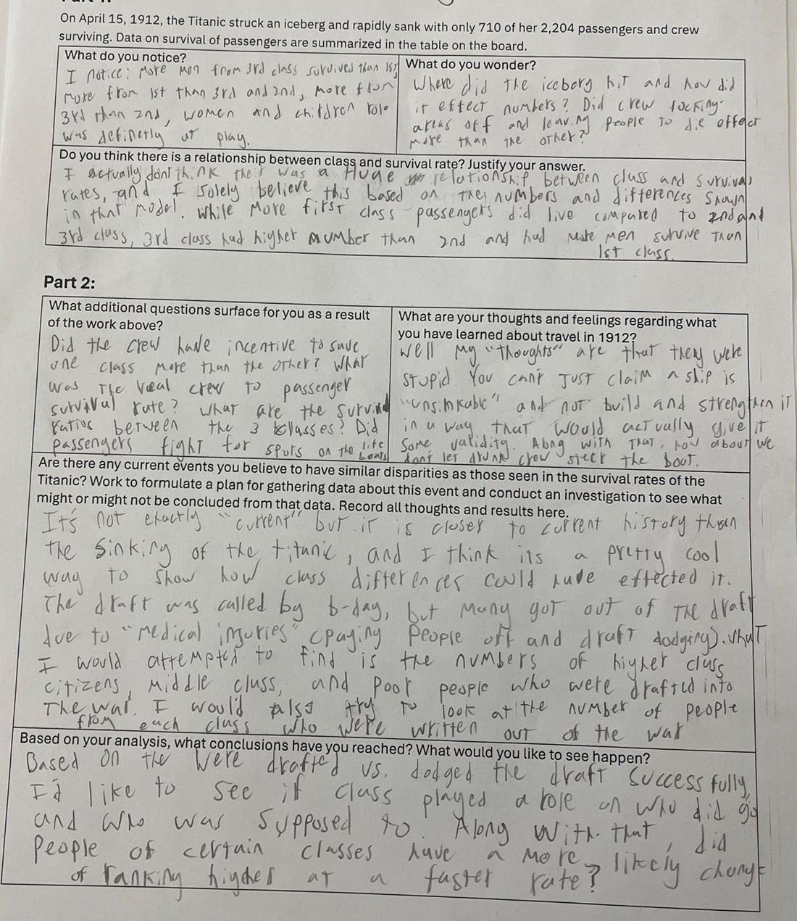
Round 1:What
do you notice?
Insert image of student work here
Jot down
One thing you notice about this piece of student work.
Notes:
Facilitation Note
Give participants time to study student work.
Share in chat:
—
Please see page 12 in your handout.
__

Slide 27
Round 1:What
do you notice?
Insert image of student work here
Jot down
One thing you notice about this piece of student work.
Come off mute and share what you saw!
Notes:
Facilitation Note
Invite participants to share what they noticed.
Look for trends in responses, especially as connected to CPE 113.e: Understand independence and conditional probability and use them for modeling.

Slide 28
Criteria for Success
Conference and Provide Revision Support | Accept with Revision | Accept
The student’s artifact shows evidence of an emerging understanding of the targeted expectation(s). After conferencing and additional instruction/learning, the student may provide a revised or different artifact as evidence of their learning. | The student’s artifact shows evidence of approaching a full understanding of the targeted expectation(s). The artifact may contain execution errors that should be corrected in revision. The student may revise the selected artifact or submit a different artifact. | The student’s artifact demonstrates evidence that they have met the targeted expectation(s).
What resonates with you? What questions surace for you?
Notes:
Facilitation Note
Introduce criteria for success.
Ask: “what resonates with you? What questions surface for you?”
Consider use of breakout groups.
Share in chat:
—
This is on page 20 of the handout.
—

Slide 29
Humanizing Assessment
Grading echoes the economic framework of testing, presuming that we can encapsulate learning in a number or a letter. Street data reminds us that our primary task as educators is to provide regular feedback to students so they can grow, not to evaluate them in order to anoint them academically capable or not.
(Safir and Dugan, 2021, p. 116)
Source: Safir, Shane, and Jamila Dugan. Street Data: A Next-Generation Model for Equity, Pedagogy, and School Transformation. Corwin, 2021.
104.i: Use a function
of exponential type l to determine values of interest in a real-world problem.
Notes:
Facilitation Note:
Share the quote. Ask participants to reflect on how the criteria and the ideas in the quote require rethinking something in their current practice.

Slide 30
Round 2:
What evidence of learning is there?
Let’s examine some work together:
Conference and Provide Revision Support
The student’s artifact shows evidence of an emerging understanding of the targeted expectation(s). After conferencing and additional instruction/ learning, the student may provide a revised or different artifact as evidence of their learning.
Accept with Revision
The student’s artifact shows evidence of approaching a full understanding of the targeted expectation(s). The artifact may contain execution errors that should be corrected in revision. The student may revise the selected artifact or submit a different artifact.
Accept
The student’s artifact demonstrates evidence that they have met the targeted expectation(s).
113.e: Understand independence and conditional probability and use them for modeling.
Notes:
Facilitation Note
Use this slide to set up what folks will do on the next slide:
They will examine the student work.
Determine where that work falls along the criteria for success spectrum.
And add a checkmark and text sharing what evidence of success is present.
We will focus our lens on the CPE displayed on the slide: 113.e

Slide 31

Examining Student Work
Conference and Provide Revision Support | Accept with Revision | Accept
Your thoughts about the evidence visible in the work.
Drag a checkmark to the Criteria for Success to reflect evidence of learning
Type out your thoughts
Notes:
Facilitation Note
Facilitator will need to make a copy of the editable Google Slide Deck and share that link with participants.
Invite participants to edit the Google slide accordingly, sharing:
Where they think the evidence of learning is along the Criteria for Success spectrum (using the checkmarks provided).
If the student was here, what question(s) would you pose to understand what they know?
Remind participants to focus on the CPEs to help guide decision making.
If they find the student work falls within the first two categories, consider inviting folks to consider and share what “conferring and additional instruction/learning” might look like for that student, as time permits.
Share that directions are on the first slide.
Navigate to Google Slides file to illustrate use of tools as needed.

Slide 32
Example #1
Let’s compare notes
Notes:
Facilitation Note
Use this slide to discuss how folks thought about the student work, in terms of the Criteria for Success chart.
This is meant to give time for group to build shared understanding of how to use the CPEs alongside the rubric to share ways of partnering with students to support all students reaching.
This is not a norming exercise; there is not single correct characterization of the work. Emphasize use of evidence and concrete next steps from each participant to support student learning.

Slide 33
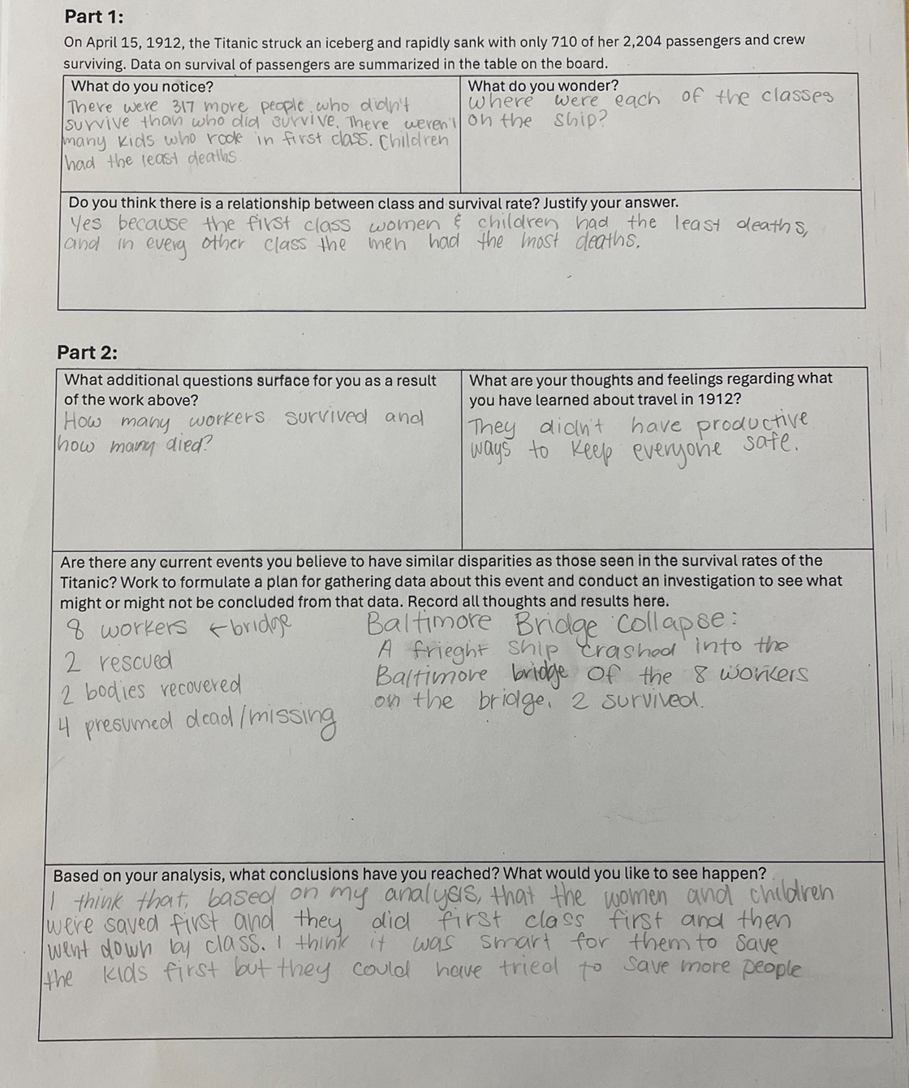
Example #2
Let’s compare notes
Notes:
Facilitation Note
Use this slide to discuss how folks thought about the student work, in terms of the Criteria for Success chart.
This is meant to give time for group to build shared understanding of how to use the CPEs alongside the rubric to share ways of partnering with students to support all students reaching.
This is not a norming exercise; there is not single correct characterization of the work. Emphasize use of evidence and concrete next steps from each participant to support student learning.

Slide 34
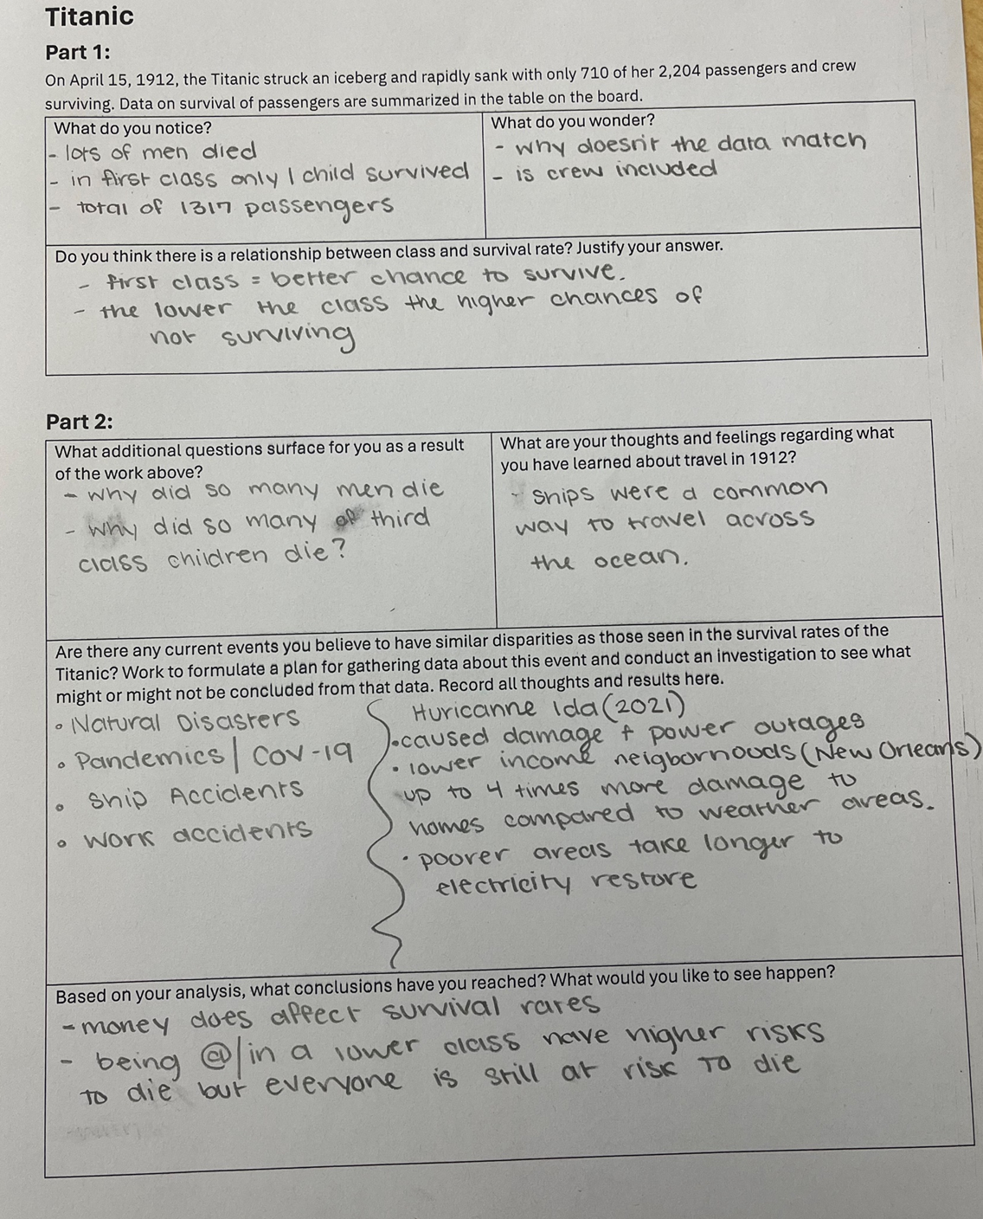
Example #3
Let’s compare notes
Notes:
Facilitation Note
Use this slide to discuss how folks thought about the student work, in terms of the Criteria for Success chart.
This is meant to give time for group to build shared understanding of how to use the CPEs alongside the rubric to share ways of partnering with students to support all students reaching.
This is not a norming exercise; there is not single correct characterization of the work. Emphasize use of evidence and concrete next steps from each participant to support student learning.

Slide 35
Three Key Components of the Math Badging System
Content and Practice Expectations
Learning Principles
Criteria for Success
Which one excites you the most?
What one will have the greatest impact on students?
What questions surface for you?
Come off
mute or share in the chat!
Notes:
Facilitation Note
Give participants time to reflect. If time permits, consider using breakout rooms to have folks connect in smaller pairings or groups.
Invite to share with whole group.

Slide 36
04
Task 2: Expectations and Learning Principles
Notes:
Facilitation Note
Estimated time for this section is about 15 minutes.

Slide 37
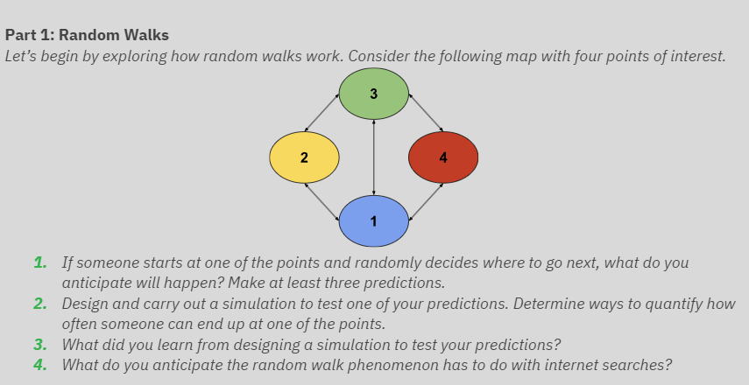
Let’s Do Some Math!
Do the task as a student would. Jot down any reflections that you have as you do the math!
Notes:
Facilitation Note
Give participants time to read through prompt and consider how students might approach this. Invite to try it out for themselves.
Share in chat:
—
Link to Handout: (insert link here)
Please see pages 15-16 in your handout.
Link to tool if needed: https://www.random.org/
—

Slide 38
Content and Practice Expectations
Choose 1-2 Content and Practice Expectations that student work could give evidence of.
Notes:
Facilitation Note
Give time to read and connect.
Consider use of breakout rooms to give participants time to discuss with small group.

Slide 39
Content and Practice Expectations
113.b: Understand and evaluate random processes underlying statistical experiments.
Notes:
Facilitation Note
Encourage participants to use the content and practice expectations (CPE) to support their thinking.
A good CPE to focus on for this task is 113.b: Understand and evaluate random processes underlying statistical experiments.

Slide 40
Learning
Principles
In M113 Modeling with Probability, students will employ the following learning principles:
Engage with cognitively demanding tasks in heterogeneous settings (LP 1).
Engage in social activities (LP 2).
Build conceptual understanding through reasoning (LP 3).
Have agency in their learning (LP 4).
View mathematics as a human endeavor across centuries (LP 5).
See mathematics as relevant (LP 6).
Employ technology as a tool for problem-solving and understanding (LP 7).
Notes:
Facilitation Note
Share that we will now be reflecting on the learning principles in relation to this task.
Give participants time to read and access the copy.
Share in chat:
—
Please see page 11 in your handout.
—

Slide 41
Learning
Principles
In M113 Modeling with Probability, students will employ the following learning principles:
Engage with cognitively demanding tasks in heterogeneous settings (LP 1).
Engage in social activities (LP 2).
Build conceptual understanding through reasoning (LP 3).
Have agency in their learning (LP 4).
View mathematics as a human endeavor across centuries (LP 5).
See mathematics as relevant (LP 6).
Employ technology as a tool for problem-solving and understanding (LP 7).
Which of these principles does this task lend itself to?
Which ones can the task be easily adapted to accommodate?
Notes:
Facilitation Note
Give time for participants to consider these questions, reflecting on the student experience associated with this task and consider how the 7 learning principles are evident.
Consider use of breakout rooms for small group conversation.

Slide 42
Learning
Principles
In M113 Modeling with Probability, students will employ the following learning principles:
Engage with cognitively demanding tasks in heterogeneous settings (LP 1).
Engage in social activities (LP 2).
Build conceptual understanding through reasoning (LP 3).
Have agency in their learning (LP 4).
View mathematics as a human endeavor across centuries (LP 5).
See mathematics as relevant (LP 6).
Employ technology as a tool for problem-solving and understanding (LP 7).
Share what
you came up with!
Notes:
Facilitation Note
Invite participants to share with the whole group.

Slide 43
05
Task 2:
Student Work
Notes:
Facilitation Note
Estimated time for this section is about 30 minutes.

Slide 44
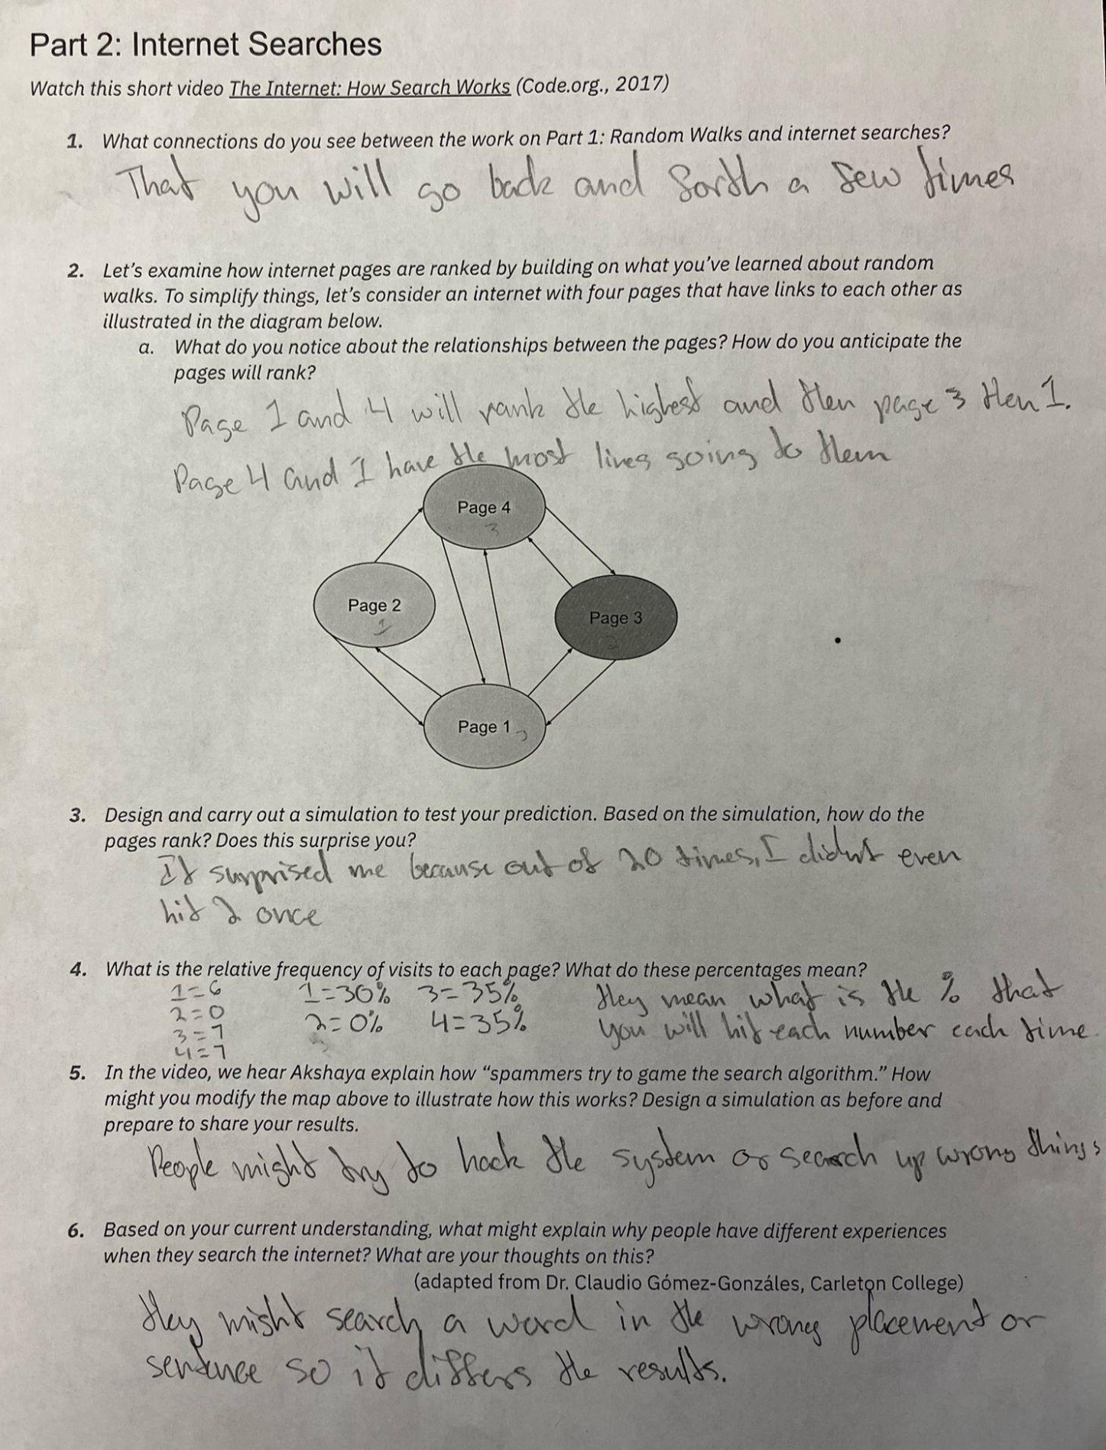
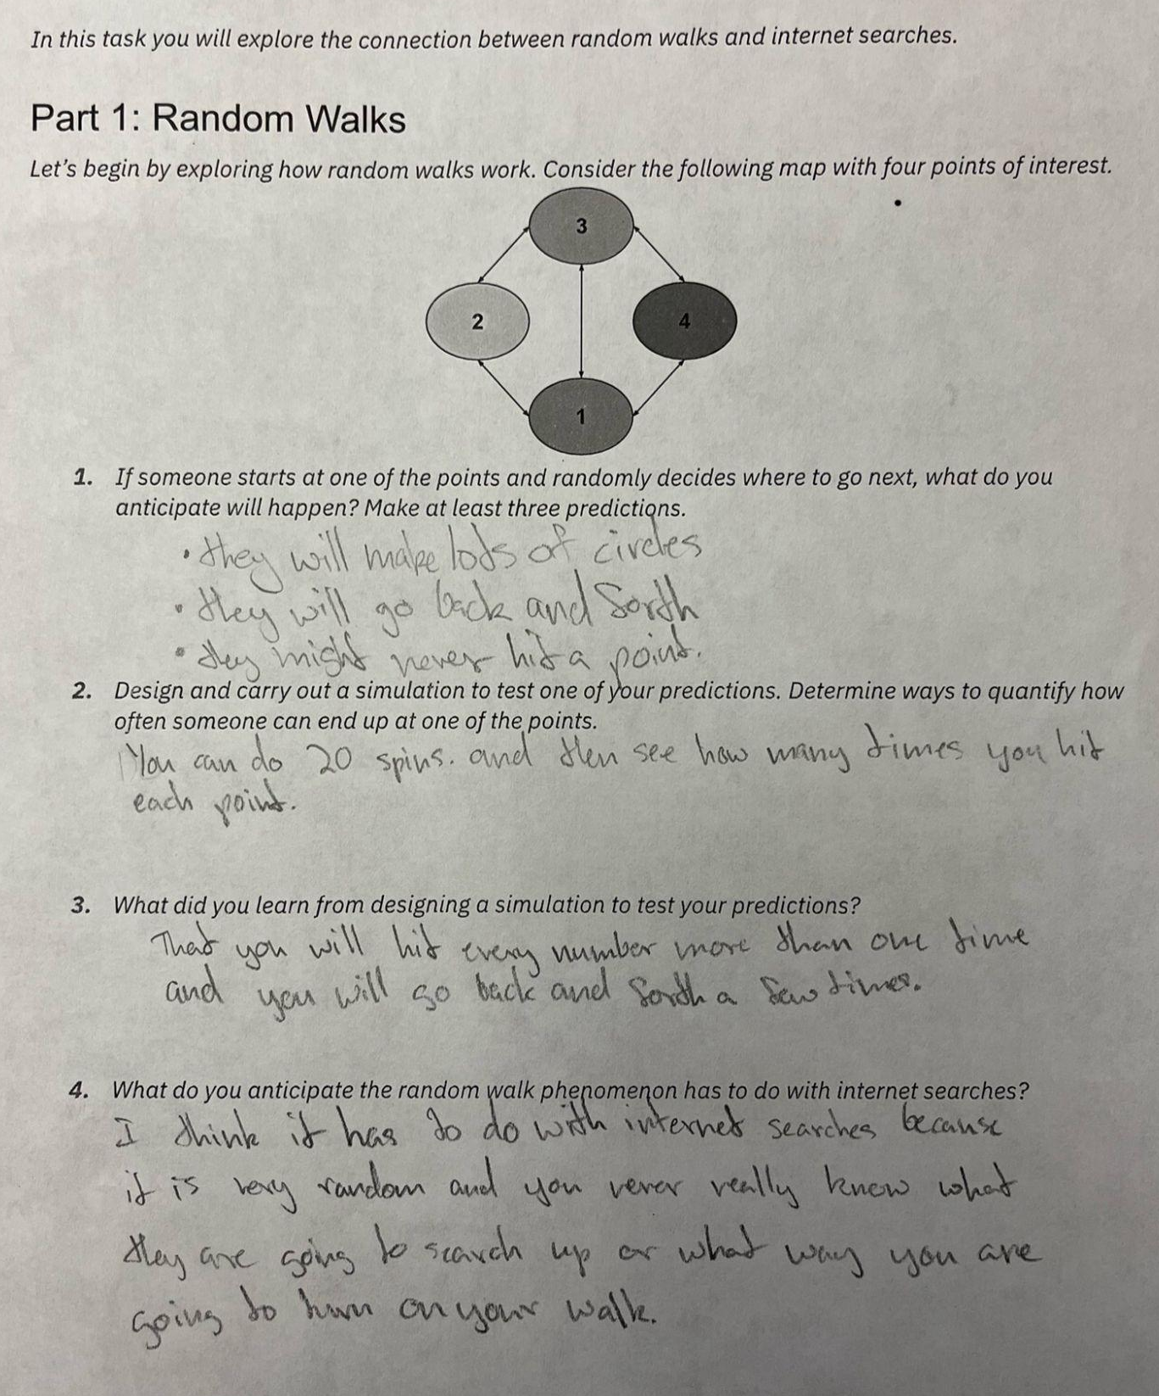
Round 1:What
do you notice?
Jot down
One thing you notice about each piece of student work.
Notes:
Facilitation Note
Give participants time to study student work.
Share in chat:
—
Please see page 17 in your handout.
—

Slide 45
Round 1:What
do you notice?
Jot down
One thing you notice about each piece of student work.
Come off mute and share what you saw!
Notes:
Facilitation Note
Invite participants to share what they noticed.
Look for trends in responses, especially as connected to CPE 113.b: Understand and evaluate random processes underlying statistical experiments.

Slide 46
What evidence of learning is there?
Let’s examine some work together:
Conference and Provide Revision Support
The student’s artifact shows evidence of an emerging understanding of the targeted expectation(s). After conferencing and additional instruction/ learning, the student may provide a revised or different artifact as evidence of their learning.
Accept with Revision
The student’s artifact shows evidence of approaching a full understanding of the targeted expectation(s). The artifact may contain execution errors that should be corrected in revision. The student may revise the selected artifact or submit a different artifact.
Accept
The student’s artifact demonstrates evidence that they have met the targeted expectation(s).
113.b: Understand and evaluate random processes underlying statistical experiments.
Notes:
Facilitation Note
Remind participants of the criteria of success.
Use this slide to set up what folks will do- next slide illustrate space to capture thinking.
They will examine the student work.
Determine where that work falls along the criteria for success spectrum.
And add a post it sharing what evidence of success is present.
We will focus our lens on the CPE displayed on the slide: 113.b

Slide 47
Examining Student Work
Conference and Provide Revision Support | Accept with Revision | Accept
Your thoughts about the evidence visible in the work.
Drag a checkmark to the Criteria for Success to reflect evidence of learning
Type out your thoughts
Notes:
Facilitation Note
Facilitator will need to make a copy of the editable Google Slide Deck and share that link with participants.
Invite participants to edit the Google slide accordingly, sharing:
Where they think the evidence of learning is along the Criteria for Success spectrum (using the checkmarks provided).
If the student was here, what question(s) would you pose to understand what they know?
Remind participants to focus on the CPEs to help guide decision making.
If they find the student work falls within the first two categories, consider inviting folks to consider and share what “conferring and additional instruction/learning” might look like for that student, as time permits.
Share that directions are on the first slide.
Navigate to Google Slides file to illustrate use of tools as needed.

Slide 48
Example #1
Let’s compare notes.
Notes:
Facilitation Note
Use this slide to discuss how folks thought about the student work, in terms of the Criteria for Success chart.
This is meant to give time for group to build shared understanding of how to use the CPEs alongside the rubric to share ways of partnering with students to support all students reaching.
This is not a norming exercise; there is not single correct characterization of the work. Emphasize use of evidence and concrete next steps from each participant to support student learning.

Slide 49
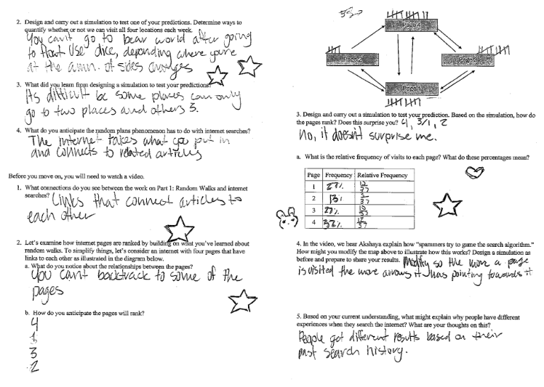
Example #2
Let’s compare notes.
Notes:
Facilitation Note
Use this slide to discuss how folks thought about the student work, in terms of the Criteria for Success chart.
This is meant to give time for group to build shared understanding of how to use the CPEs alongside the rubric to share ways of partnering with students to support all students reaching.
This is not a norming exercise; there is not single correct characterization of the work. Emphasize use of evidence and concrete next steps from each participant to support student learning.

Slide 50
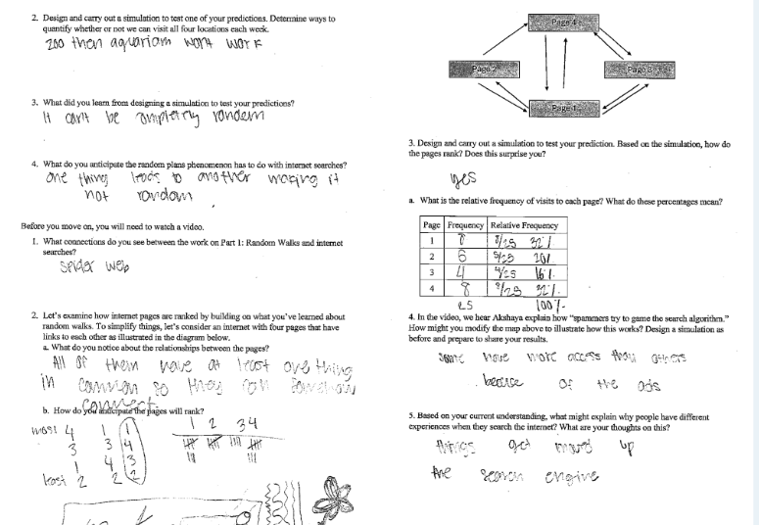
Example #3
Let’s compare notes.
Notes:
Facilitation Note
Use this slide to discuss how folks thought about the student work, in terms of the Criteria for Success chart.
This is meant to give time for group to build shared understanding of how to use the CPEs alongside the rubric to share ways of partnering with students to support all students reaching.
This is not a norming exercise; there is not single correct characterization of the work. Emphasize use of evidence and concrete next steps from each participant to support student learning.

Slide 51
Let’s Hear Some Reflections
What kinds of support will students need to demonstrate evidence of learning?
Has your thinking changed at all on how to implement this task? If so, how?
Come off
mute or share in the chat!
Notes:
Facilitation Note
Give participants time to reflect. If time permits, consider using breakout rooms to have folks connect in smaller pairings or groups.
Invite to share with whole group.

Slide 52
06
Closing
Notes:
Facilitation Note
Estimated time for this section is about 5 minutes.

Slide 53
What Are Your Takeaways?
Choose one question to respond to:
Which content and practice expectation are you most excited about? Why?
Which learning principle are you most excited about connecting to M113 content? Why?
What impact do you think using a portfolio system will have on your students? Why?
Notes:
Facilitation Note
Give participants time to reflect. If time permits, consider using breakout rooms to have folks connect in smaller pairings or groups.
Invite to share with whole group.

